Slide 1
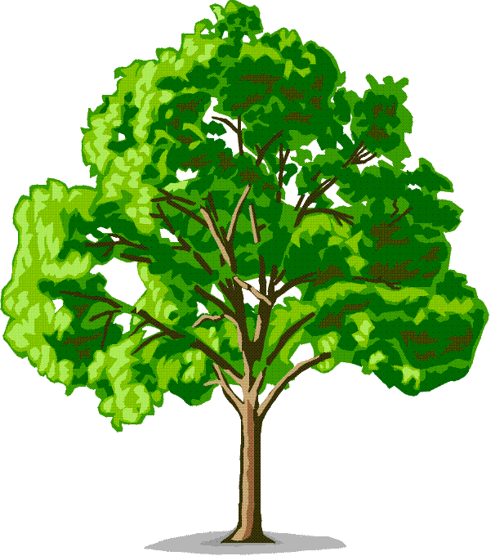

Magnificent Mycorrhizae
The Effect of Buildings on Mycorrhizae
By: Becky Blackstone, Anna Cox, Bridget Lavelle, and Mary Bryan Owen

Slide 2
Introduction to our Problem and Its Nature

Slide 3
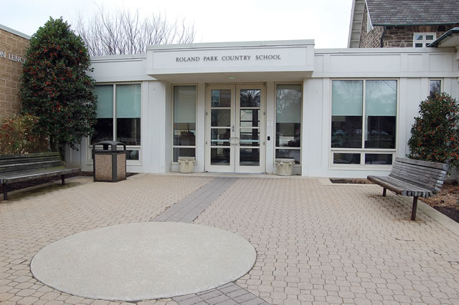
The Problem
We wanted to figure out if our school
is affecting the population of
mycorrhizae living in the soil
around trees surrounding the
school

Slide 4

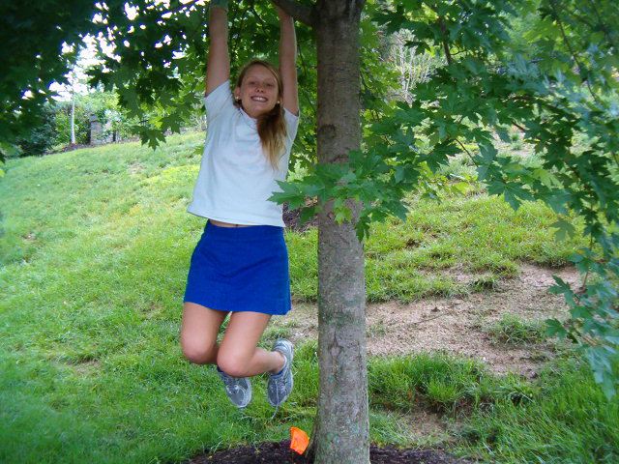
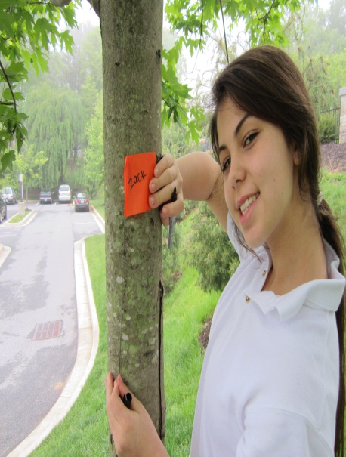


So we asked our friends if they knew…
Cody
Bertha
Zack
Sasha
Greg

Slide 5
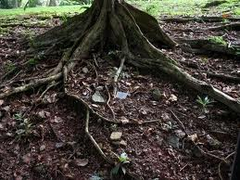
Bertha, Sasha, Zack, Cody, and Greg told us all about their Mycorrhizae
Mycorrhizae helps us absorb nutrients like phosphorous and nitrogen through our roots, which is crucial to our survival as trees. Even though we love our friends, Becky, Bridget, Anna and Mary Bryan, they can negatively influence the soil where we live.
Mycorrhizae is so helpful! I was able to absorb nutrients such as Nitrogen and Phosphorous more easily!
N
P

Slide 6
And about its functions and benefits
Mycorrhizae also provide other benefits that increase my longevity. The network of hyphae, for example, help to hold the soil together, making irrigation easier and providing weed resistance. Furthermore, the mycorrhizae help protect my roots from diseases, and keep me from getting stressed.
I must protect the plant’s roots, away disease!

Slide 7


And lastly about the effects of the building
When the school was built, soil was ripped from the ground, therefore disturbing the mycorrhizae living in it. The soil surrounding the school is being disturbed by gardens and other landscaping. The areas with the most landscaping are in closer proximity to the school.
Oh no! the mycorrhizae!

Slide 8
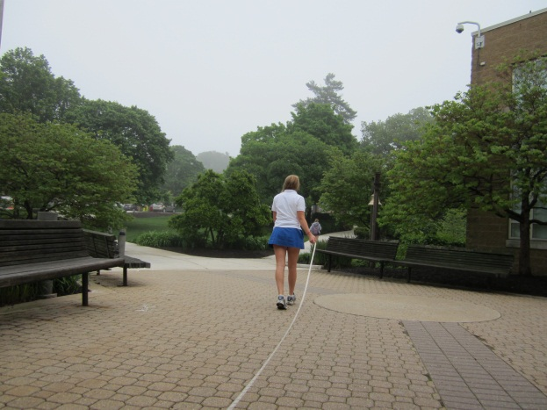
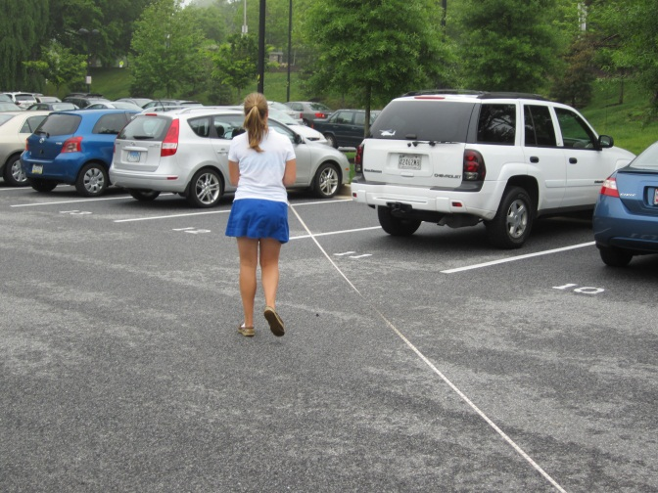
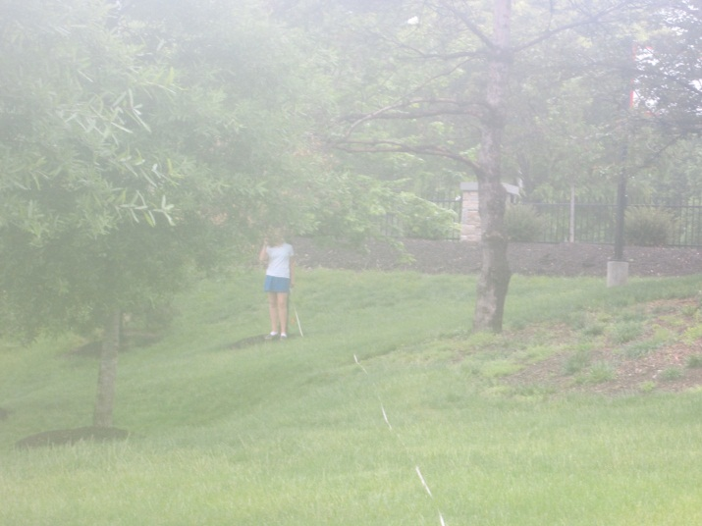
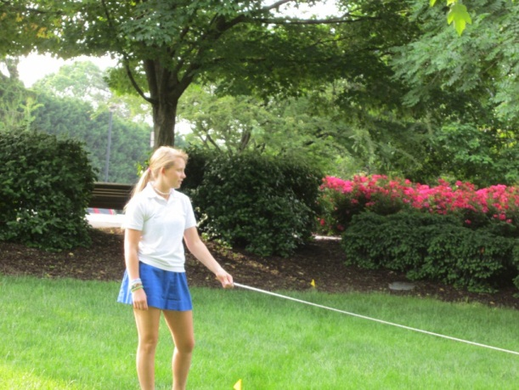
So we decided to take action!
First we measured all of the tree’s distances from the school, and their friend Greg’s, a lovely soil plot

Slide 9
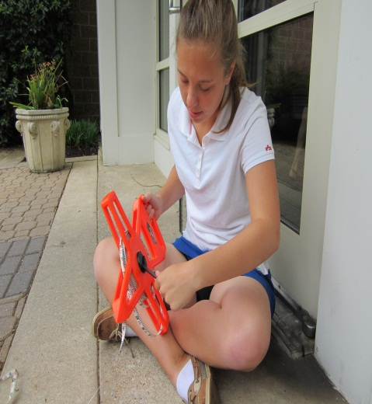
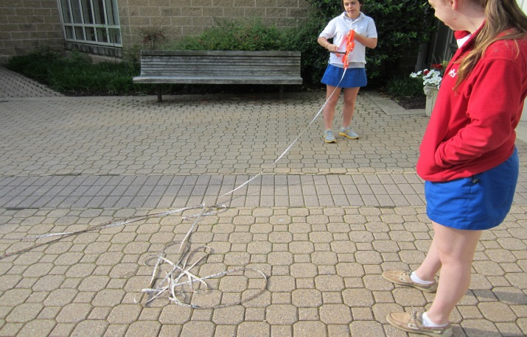
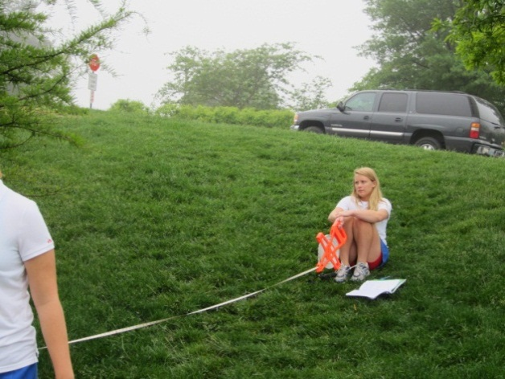
And then we wound the tape measurer up…
And more winding!
winding
and winding
#soilecologygirlprobs

Slide 10
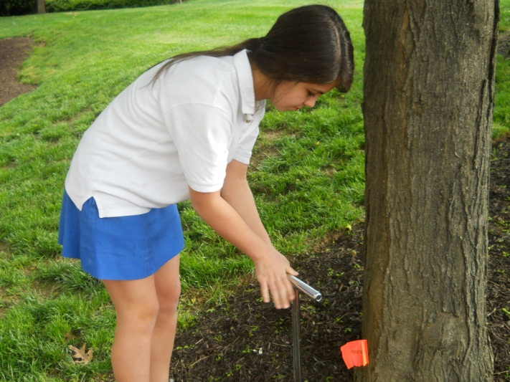
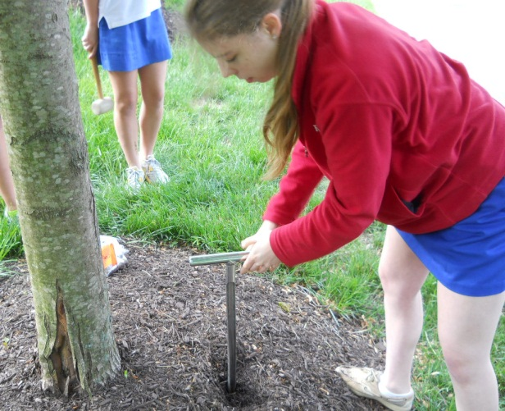
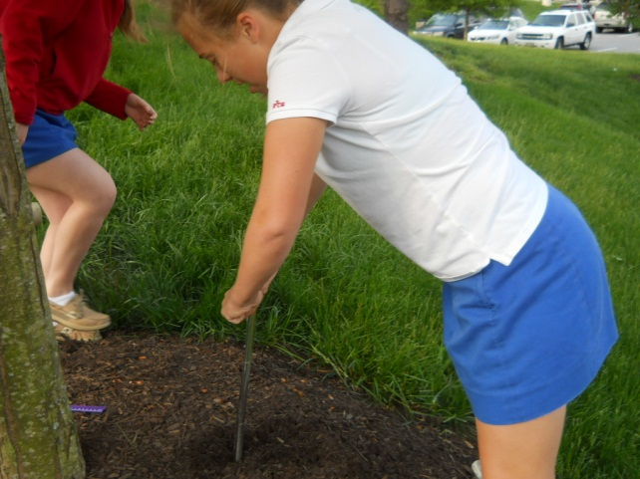
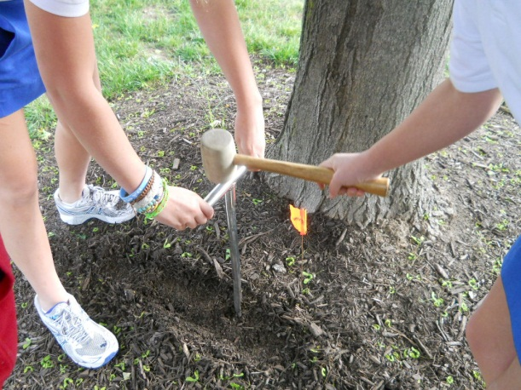
Next we took a soil sample from all the trees and Greg

Slide 11
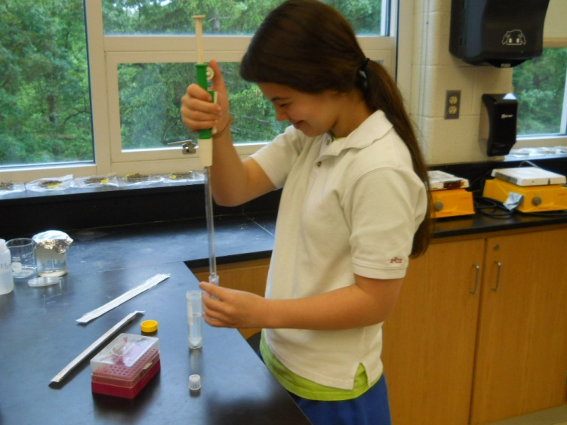
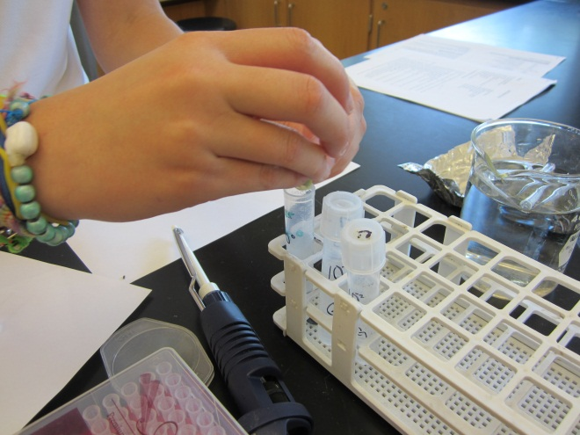
Then we did serial dilutions for all of the soil samples
First we filled culture tubes
with sterile water
Then we put our soil
samples in the water

Slide 12
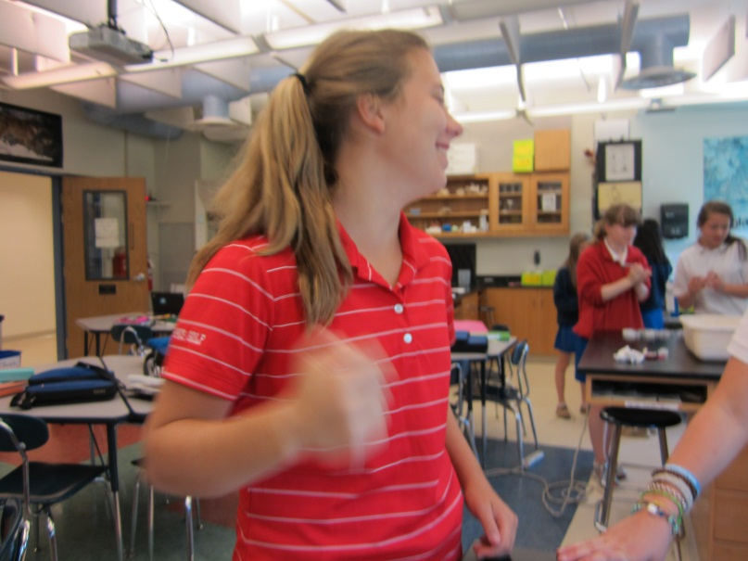

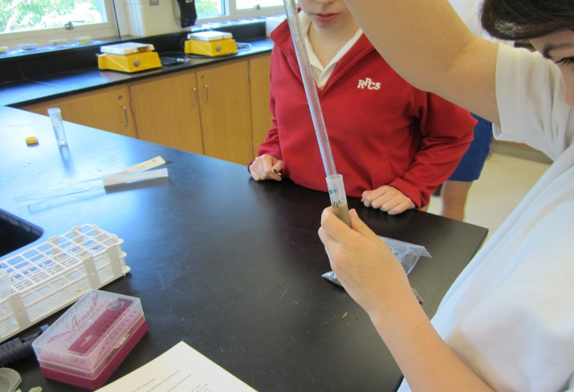
And transferred it to another culture tube
Then we shook it up
And another!

Slide 13
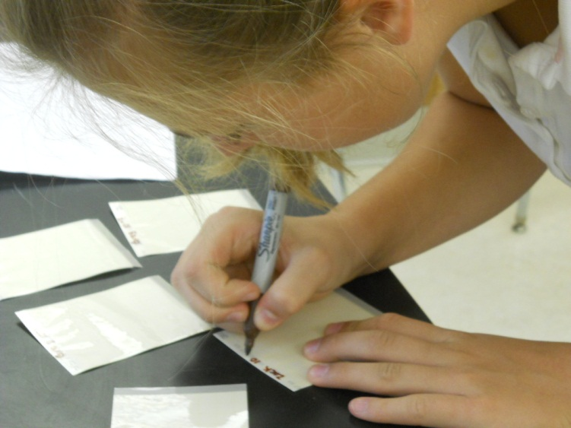
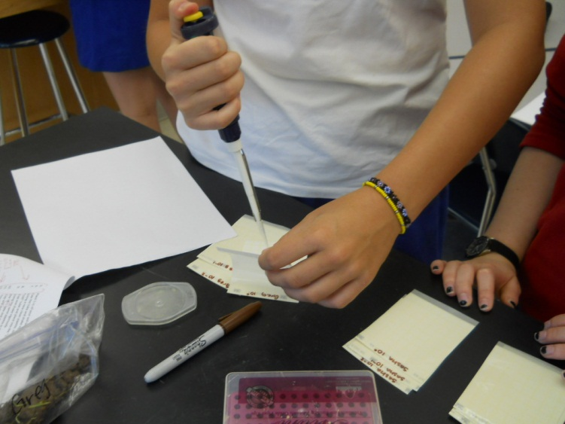
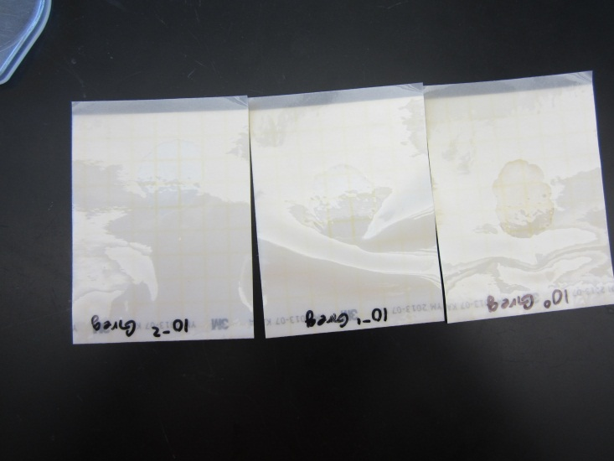
Next we labeled petri plates
and put the soil solution on them
And ended up with this

Slide 14
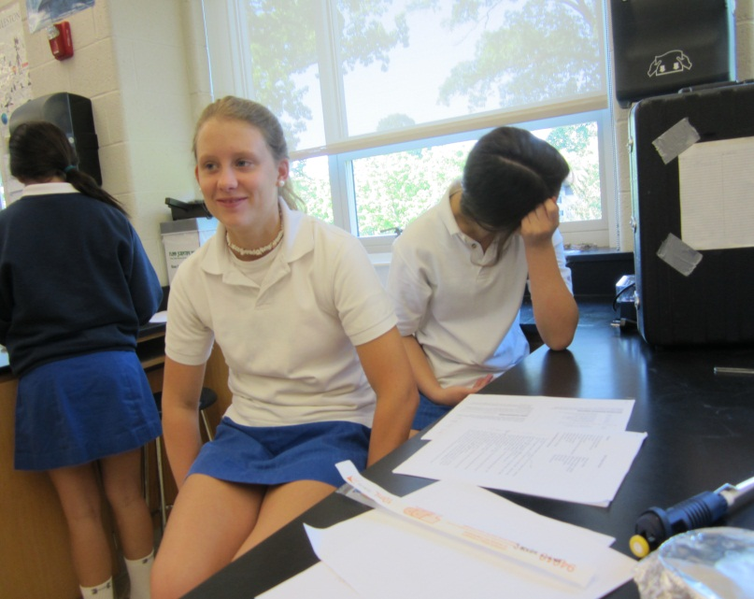
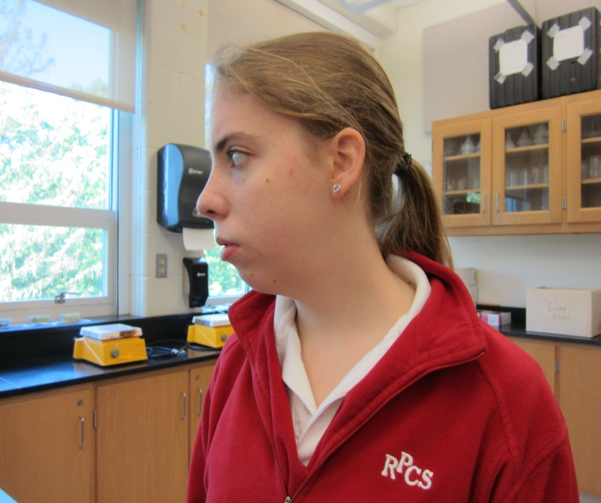
Then we waited 48 hours…
#soilecologygirlprobs
And then we counted the amount of mold and yeast in each of the fifteen serial dilutions

Slide 15
Results and Conclusions

Slide 16
Here are our results:
Data Table of the Average Amount of Mold and Yeast
Sample | Trial | Density of Mold in 1 cc of soil | Average Mold density in 1 cc of soil | Density of Yeast in 1 cc of soil | Average Yeast density in 1 cc of soil | Total Fungi density in 1 cc of soil | Average density in 1 cc of soil
Greg (42 m.) | 1 | 3000 | 18000 | 2000 | 1333 | 5000 | 3133
 | 2 | 400 |  | 1000 |  | 1400
 | 3 | 2000 |  | 1000 |  | 3000
Sasha (25 m.) | 1 | 4000 | 2333 | 1000 | 4333 | 5000 | 6667
 | 2 | 1000 |  | 10000 |  | 11000
 | 3 | 2000 |  | 2000 |  | 4000
Cody (171 m.) | 1 | 20000 | 8333 | 14000 | 5867 | 34000 | 14200
 | 2 | 4000 |  | 3000 |  | 7000
 | 3 | 1000 |  | 600 |  | 1600
Bertha (82 m.) | 1 | 4000 | 2666 | 400 | 1133 | 4400 | 3800
 | 2 | 3000 |  | 1000 |  | 4000
 | 3 | 1000 |  | 2000 |  | 3000
Zack (142 m.) | 1 | 3000 | 24333 | 10000 | 14333 | 13000 | 38666
 | 2 | 30000 |  | 3000 |  | 33000
 | 3 | 40000 |  | 30000 |  | 70000

Slide 17
Graph of the Density of Yeast in 1 cc of Soil

Slide 18
Graph of the Density of Mold in 1 cc of Soil
The correlation for the density of the yeasts was 0.14, while the correlation for the density of the mold was 0.23. This shows that overall the soil was a good environment for fungi, because there is a higher correlation for the density of the mold.

Slide 19
Graph of the Total Fungi Density in 1 cc of Soil

Slide 21
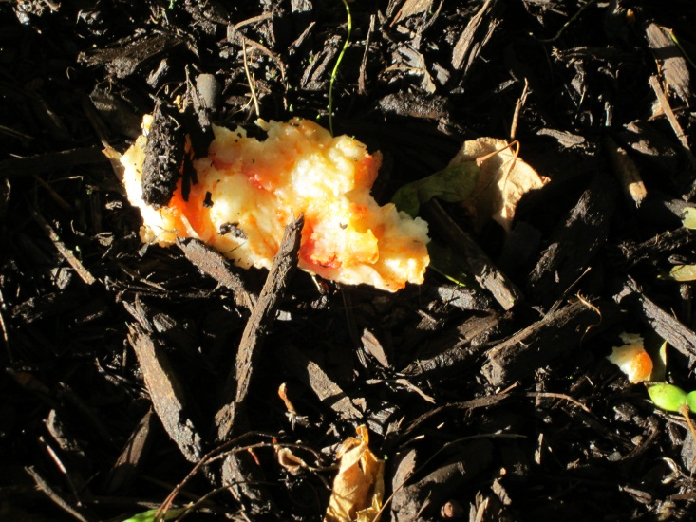

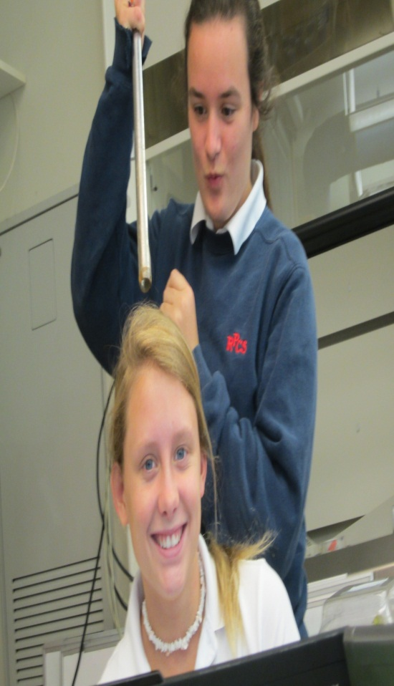
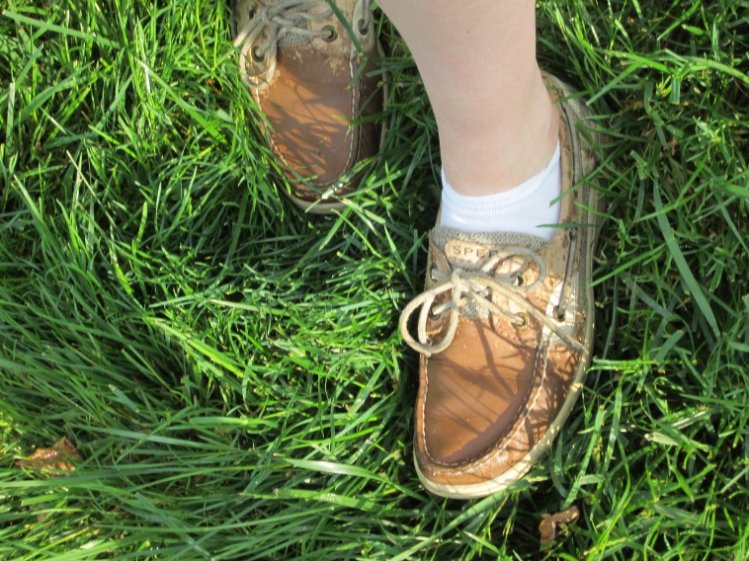
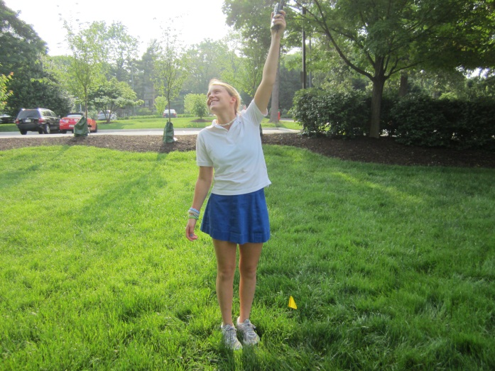
And after all that hard work and struggle…
#Soilecologygirlprobs

Slide 22


We learned that our hypothesis was right because if soil has more yeast, it means that its environment is less suitable for fungi.
If the soil has more mold, it means that its environment is more suitable for fungi.

Slide 23
We found that Sasha's soil had more yeast than mold!
Not Fair!

Slide 24
But Bertha, Zack and Cody had more mold than yeast. The soil around Bertha, Zack, and Cody is more suitable for fungi than the soil around Sasha.
YAY!!!!

Slide 25
#soilecologygirlprobs
Instead of taking new soil samples from each tree for each trial, we used the same soil samples for every trial. However, we completed the trials at different times, so we were still able to use the data.

Slide 26
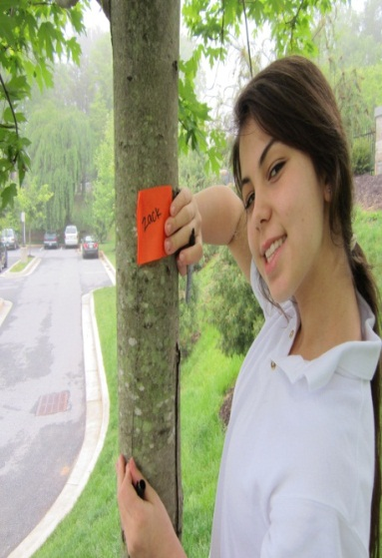
Future Problem
In the future, we could test to see what about Zack’s soil environment made it more suitable for fungi.

Slide 27
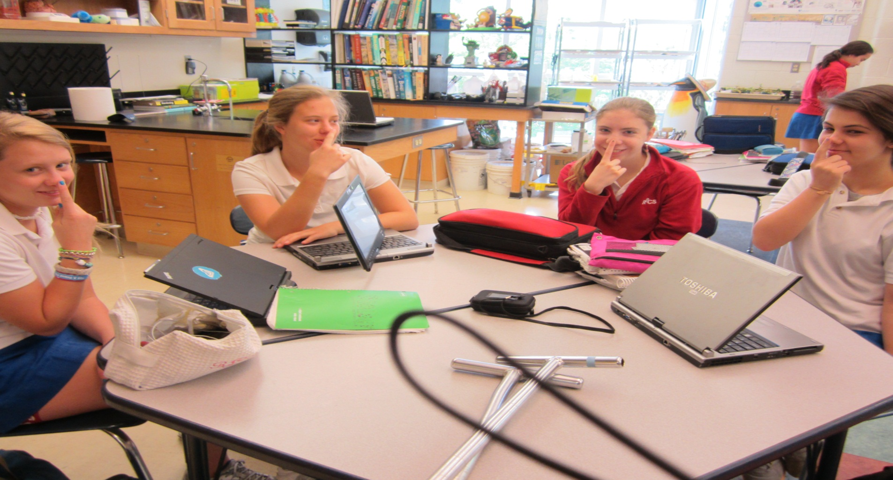
Thank You!

Slide 28
Sources
Friemann. (n.d.) Proteins and Nucleic Acids. Union Mine High School. http://umhs.eduhsd.k12.ca.us/departments/science/freimann/AP%20Bio% 20ppt/Proteins%20and%20Nucleic%20Acidspp.pdf
Griffith, B. (year unknown) Phosphorus. Rainbow Plant Food. http://www.rainbowplantfood.com/agronomics/efu/phosphorus.pdf
New York Botanical Garden. (2003) Hidden Partners: Mycorrhizal Fungi and Plants. New York Botanical Garden. http://sciweb.nybg.org/science2/hcol/mycorrhizae.asp
St. John, T. (year unknown) The benefits of mycorrihizal inoculation. Dr. Ted's Chunky Style Myco-bits. http://www.mycorrhiza.net/benefits.htm
Swift, C. (2004) Mycorrhiza and soil phosphorous levels. Colorado State University Cooperative Extension. http://mining.state.co.us/TechnicalBulletins/MycorrhizaAndSoilPhosphorusL evels.pdf
Todd, C. (2004.) Mycorrhizal Fungi, Nature’s Key to Plant Survival and Success. Pacific Horticulture. http://www.pacifichorticulture.org/articles/65/1/mycorrhizal-fungi-natures- key-to-plant-survival-and-success/
Trappe, J. (2012). Mycorrihzae. Access Science. http://www.accessscience.com/content/Mycorrhizae/441900
Songs
Coldplay - Paradise (Instrumental) (official music new song 2011)
The Suite Life Theme Song!
Suite Life of Zack and Cody Instrumental version
Pictures
clipart

