Slide 1

Princess Fiona-Fungi’s Adventure
Written by: Sally Askew, Savannah Emge, and Sophie Shippe

Slide 2

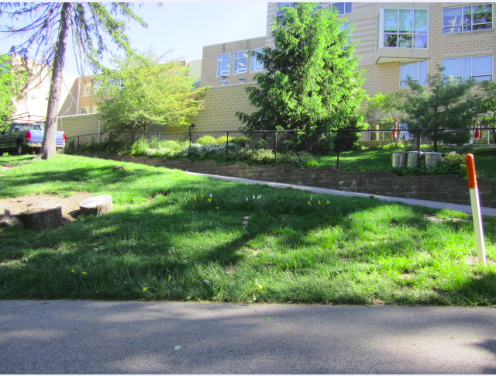
Once upon a time, on a hill very close to Roland Park Country School…

Slide 3
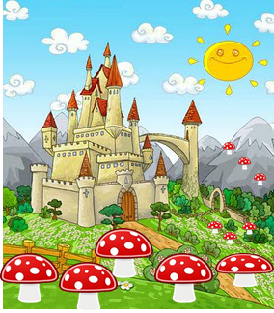
There lived a kingdom of Fungi

Slide 4



that was inhabited by
and the Fungi Footmen...
Melvin the Mold
Princess Fiona...
Yolanda the Yeast

Slide 5


The kingdom of Fungi worked very hard to break down dead matter and convert it into useful things such as carbon and nutrients for the plants above them.

Slide 6



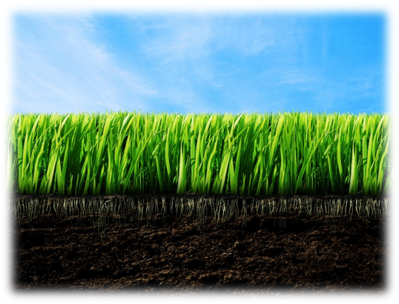
The work of the Kingdom was very important because without it, everyone around, in, and even above the kingdom would die.
Notes:
put Xs over fungi

Slide 7

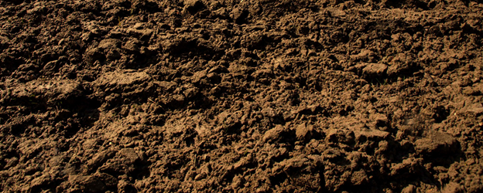

Since the fungi give the plants nitrogen, which is the most important element, they have one of the most important jobs.Knowing this, when she was little, princess Fiona asked her mom why nitrogen was so important, and her mom explained as simply as she could.

Slide 8


“Without nitrogen,” said her mom, “the plants above us would not be able to make DNA, RNA, and enzymes. These are very important because they let them do things.”

Slide 9

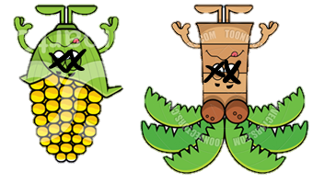
“Without them, the plants would not be able to do anything like make themselves food, and they would die,” continued her mother. Princess Fiona finally understood how essential her kingdom was.

Slide 10

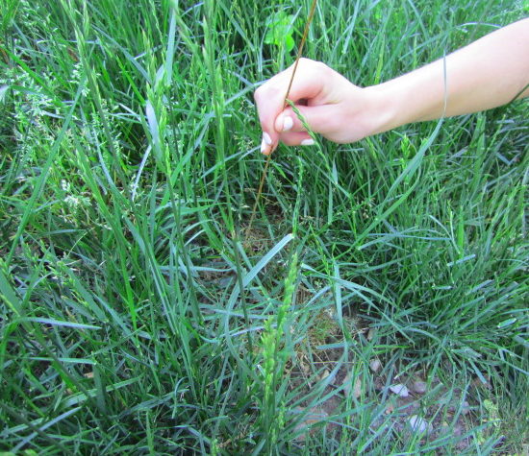

One day Princess Fiona-Fungi looked up and noticed…
poles flying out of the sky!

Slide 11


?
She asked her footmen to investigate, but they found nothing to help the investigation.

Slide 12
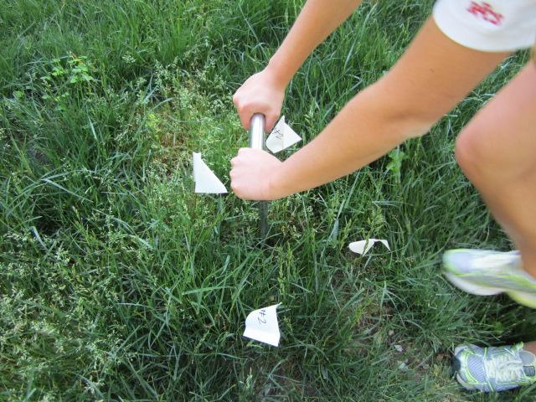
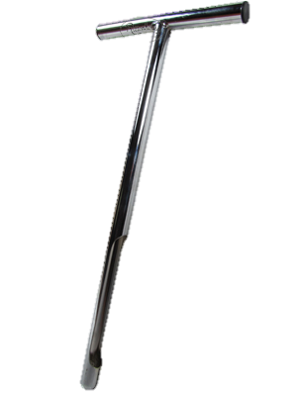

The next day, she noticed holes being drilled through the sky. Shrilly, she screamed at her men to find out what was happening.

Slide 13
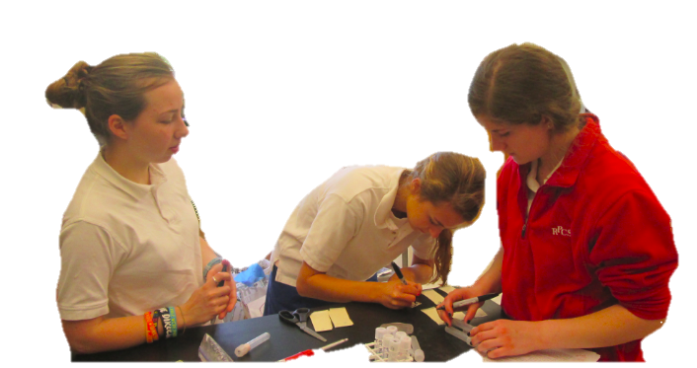



The footmen ran to the intrusion and heard a female, who they assumed was a witch, asking,“Does water erosion alter where the saprotrophic fungi populations are found on a hill side?”

Slide 14

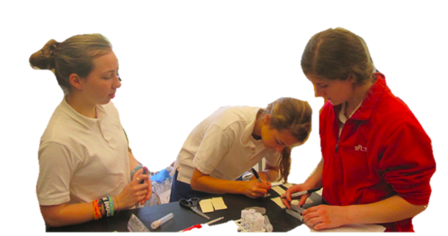

Another witch answered,“I hypothesize that water erosion decreases the saprotrophic fungi population at the top of a hill and increases the saprotrophic population at the bottom of the hill.”

Slide 15




The footmen quickly hurried back to Fiona and reported to the princess what they observed.
I heard Saprotrophic fungi!
I heard water erosion!

Slide 16
The Princess was not familiar with the terms, so she requested for the footmen to research what water erosion and saprotrophic fungi were.
?

Slide 17
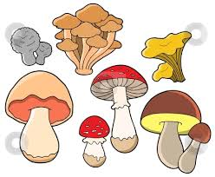
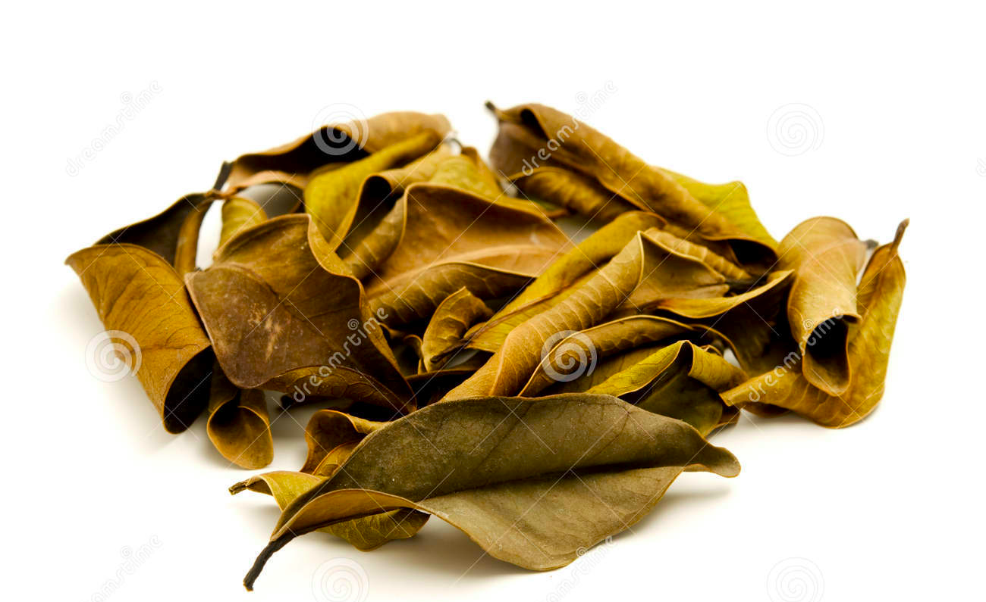

The footmen reported to the Princess their newfound knowledge. They informed the princess what saprotrophic fungi were and explained that saprotrophic fungi were fungi that get their nutrients from dead organic material.

Slide 18
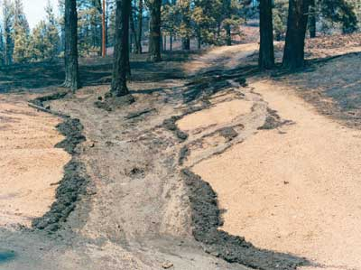
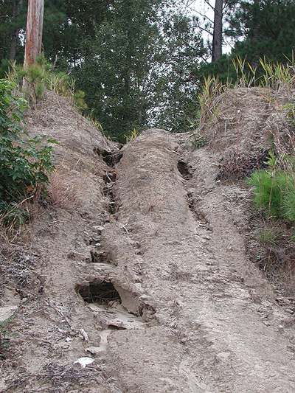

They informed the Princess that water erosion was when running water transported soil particles until it finished moving and deposited the particles in a new place.

Slide 19
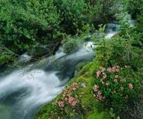





The footmen also told her that water erosion was a big problem. Since it takes away the topsoil, it could wash away all the fungi!

Slide 20

Water erosion has the potential to mess up the whole ecosystem, so it must be the wtiches doing this!
With fewer fungi in the soil, plants would not be able to grow because they wouldn’t get any nitrogen from the fungi, and this would cause there to be fewer plants for animals to eat.

Slide 21
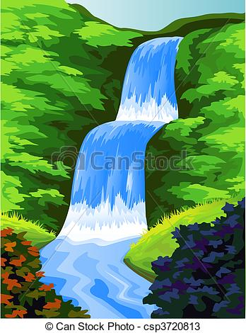


The next day, the witches poured an abudance of water down the hill which washed away the kingdom including the princess and all her friends. They eventually landed at the bottom of the hill.

Slide 22
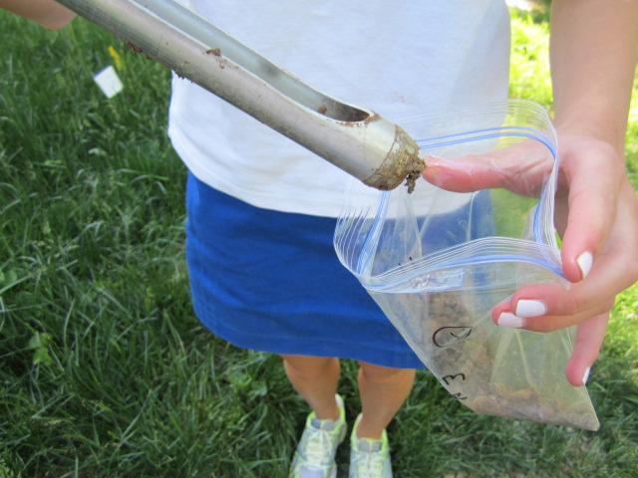

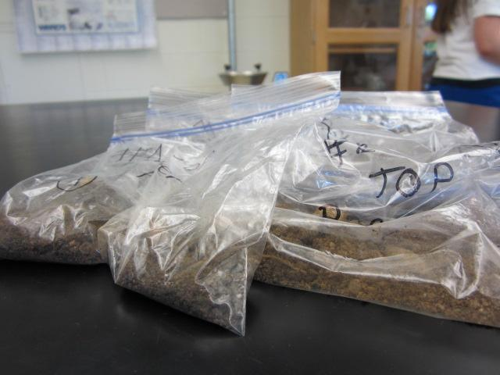
The following morning the princess was taken from the soil by the witches, brought above ground and placed in a plastic bag along with more soil!

Slide 23
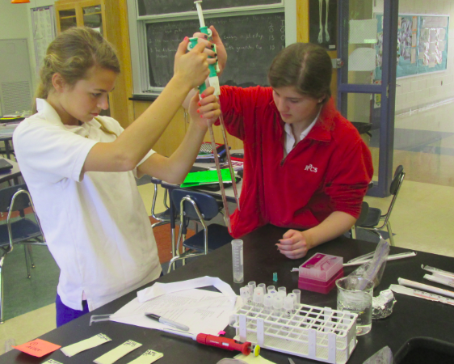
The princess was then scooped into a tube filled with clean water and shaken vigorously. Fiona Fungi was very dizzy from this, and when she thought it was over, the witches repeated the process two more times!

Slide 24
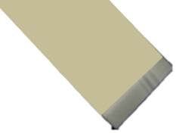
After being shaken around, the princess was placed dizzily inside a tube and squirted onto a yellow piece of paper.

Slide 25
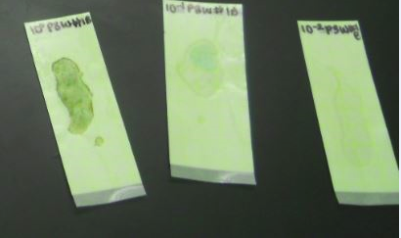

The princess waited and waited on the paper. While she was waiting she grew and grew along with a new friend, Frank, and her old friends, Melvin and Yolanda, because the witches provided them with delicious food.

Slide 26
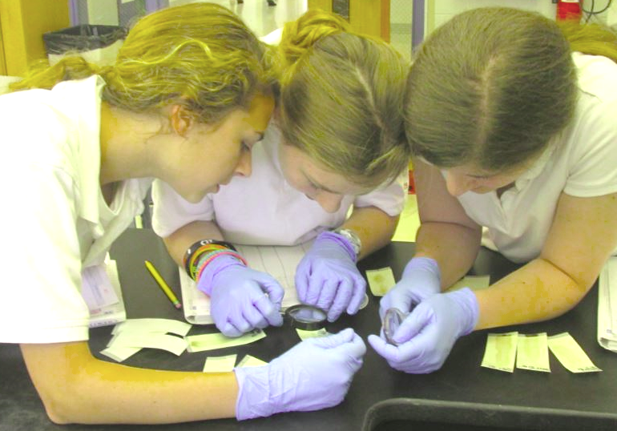
After about 3 days of sitting and growing, the princess and her friends were examined by the three witches with magnifying glasses.

Slide 27
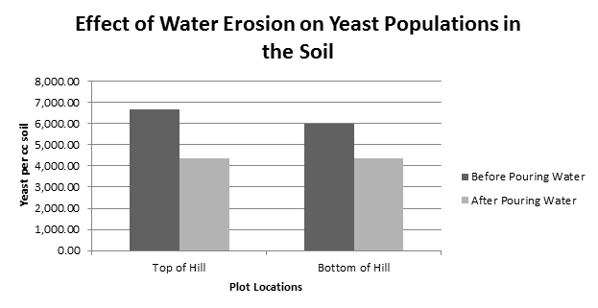
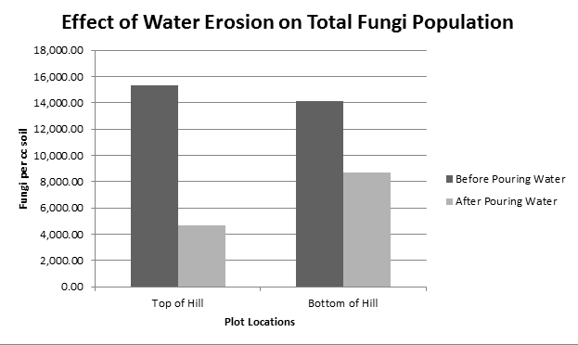
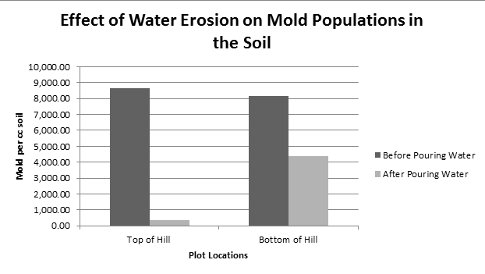
A while later, princess Fiona turned her head and saw pieces of paper that helped her come to a conclusion about what the witches were doing.

Slide 28

Later, princess Fiona and Frank, who had a pet rock, wiggled off of the paper, because they were about be thrown into a biohazard bag, and rode home on Frank’s rock.

Slide 29
When they arrived at home, Princess Fiona and Frank discussed their experience.
Exactly! The mold population had a very drastic decrease at the top plots but not as severely at the bottom plots.
Three witches were performing an experiment about the impact of erosion on fungi density. I think their guess about its effect was wrong because the fungi population at the bottom and top of the hill both decreased, even though they thought the population at the top would decrease and the population at the bottom would increase.
What did you think?
Right! Also, the yeast population had a stable decrease which indicates that there was another environmental factor impacting the yeast population. Hopefully in the future the witches can test the impact of temperture on the yeast populaton because I think that’s what caused it.

Slide 30

Then, Princess Fiona and Prince Frank lived happily ever after!

Slide 31
Works Cited:
http://galleryhip.com/old-leather-blank-book-cover.html
http://www.deviantart.com/art/open-book-template-PSD-198829525
http://mykpopfanfic.wordpress.com/2010/04/02/frog-kingdom/cartoon-castle/
http://images.clipartlogo.com/files/images/40/400384/mushroom-clip-art_t.jpg
http://vector.me/files/images/2/3/234678/cartoon_mushrooms_vector_set.jpg
https://www.etsy.com/market/bacteria
http://uhome.in/wp-content/uploads/2012/07/cartoon-plants-and-flowers.jpg
http://www.wallpapersfunny.com/wallpapers/nature-plants-green-grass-funny-wallpaper-1024x768.jpg
http://www.clipartof.com/portfolio/cthoman/illustration/sick-corn-mascot-1125600.html
http://www.toonvectors.com/clip-art/cartoon-palm-tree-sick/38861
https://sites.psu.edu/seanwoconnor/the-perils-of-photoshop/
http://www.colesvillenursery.com/wp/wp-content/themes/colesville-nursery/images/header-photo-the-dirt.jpg
http://lowres.jantoo.com/industry-factory-factory_worker-production-products-production_line-00800159_low.jpg
http://foodwallpaper.info/healthy-food-clipart/

