Slide 1
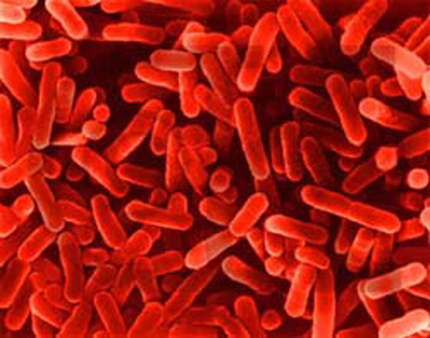
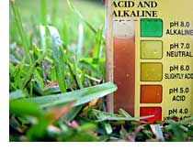

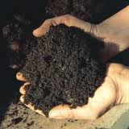

The Effects Of Acid Rain on Bacteria
SOIL ECOLOGY PROJECT
By: Jamie Allen, Kendra Foster, Claire Mullican, and Susan Radov

Slide 2
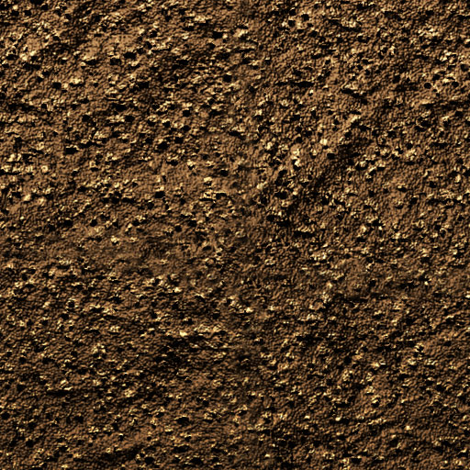
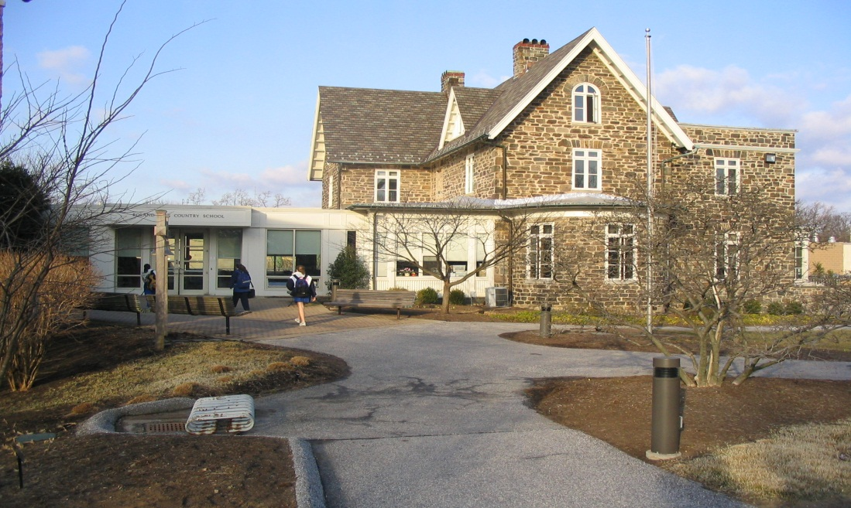


A small baby bacteria named Bobby lived in the soil at Roland Park Country School. He lived with his Mama Margaret, his Papa Peter, and lots of his bacteria friends.
Mama Margaret
Papa Peter
Baby Bobby

Slide 3
Mama Margaret
Papa Peter
Oh. Do you mean the information about pH? He was saying that low pH kills us and that we survive in mostly high pH.
Indeed. This toxic rain has killed so many of my relatives. I mean a little sulfuric acid goes a long way, but all of this is just murderous.
Yeah! Even those massive creatures that make soap to kill us would never be able to live without us. But they have no idea how they affect our environment. I heard that they make these things called cars and other junk that puts all this waste into our environment. How rude!
Yeah, yeah! And he said that this acid rain is causing the pH to lower. And I think we all know what that means……
I remember that! Yeah, and enzymes/proteins are really important for all the organisms on this gigantic earth!
Yeah! Hmm…what was that thing Mr. Rockin’ Brock was talking to us about yesterday? Besides the stuff about enzymes/proteins….
Yeah, dude that stuff kills.….
See this nitrogen we release is used for amino acids. Mr. Rockin’ Brock explained yesterday to us in class that amino acids make up enzymes/proteins.
Oh, just the usual. I'm releasing nitrogen.
Well, yeah I guess…..
All of what?
You know, the releasing of nitrogen. I mean our job is pretty important, isn't it?
Hey Larry, what are you doing over there?
Last night I was thinking about all of this.
Lovable Larry
Baby Bobby

Slide 4
Once Larry finished speaking, acid rain started falling from the sky!! Numerous bacteria friends were dying..
Mama Margaret
Papa Peter
Baby Bobby

Slide 5
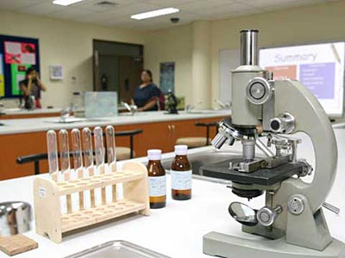




MEET THE MEMBERS OF THE ACE TEAM RPCS!!
Bobby was scared and did not know what to do. So, he used his telepathic ways to channel the best in the business, the ace team RPCS, to get to the bottom of the acid rain problem.
Susan
Jamie
Kendra
Claire

Slide 6
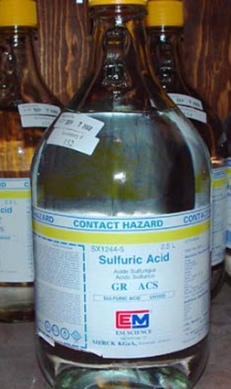
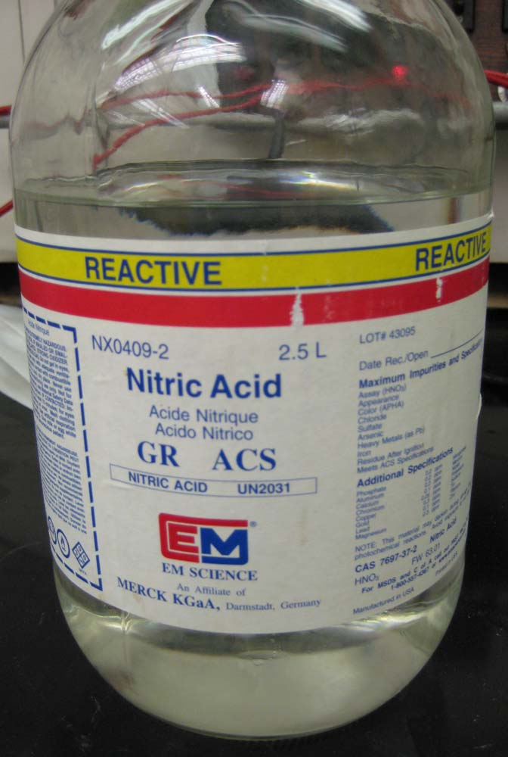
SULFURIC ACID
NITRIC ACID
After doing some research, the girls from the ace team RPCS decided that the problem facing Bobby and his friends was either the sulfuric acid or nitric acid in acid rain.

Slide 7


The girls then hypothesized that sulfuric acid, an element in acid rain, was the culprit. They thought it was this that specifically lowered the pH levels making it more acidic. They also thought that the sulfuric acid decreased the number of bacteria.
I AM SULFURIC ACID! MWUAHAHA!!!!!

Slide 8
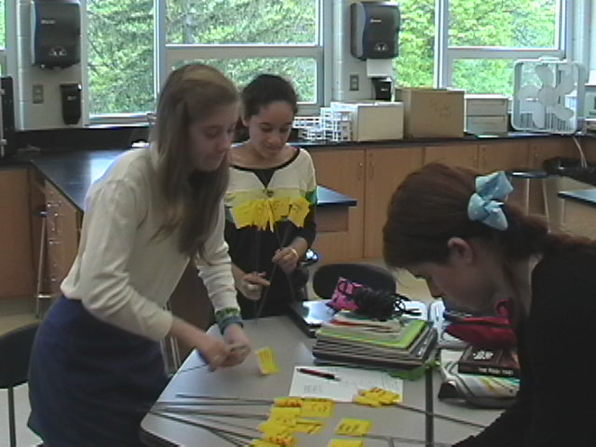
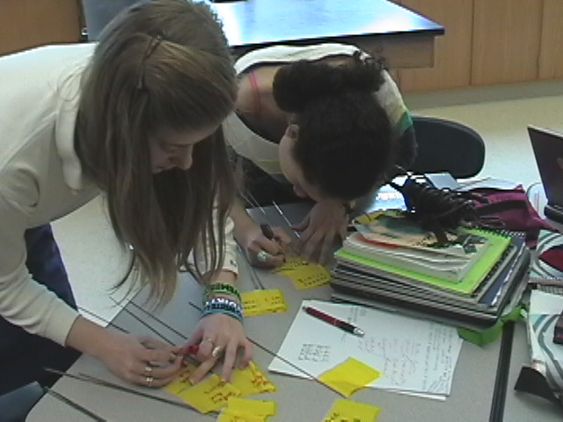
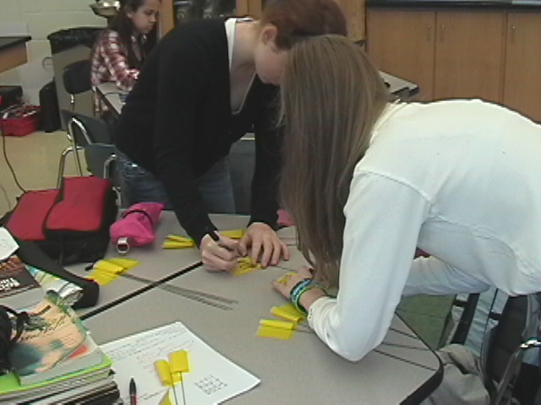
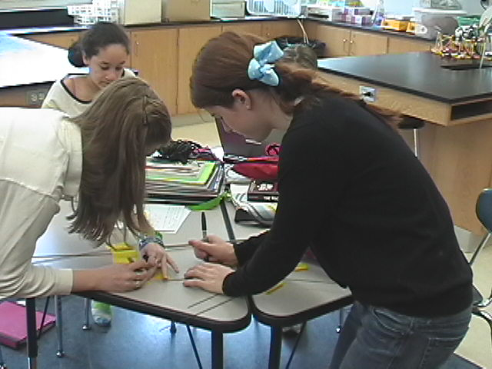
The ace team RPCS then started to conduct their experiment. To begin, they labeled yellow flags to later mark the various squares of soil where acid was to be later put in.

Slide 9
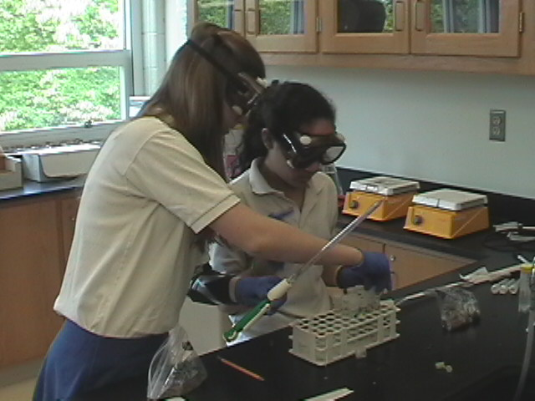
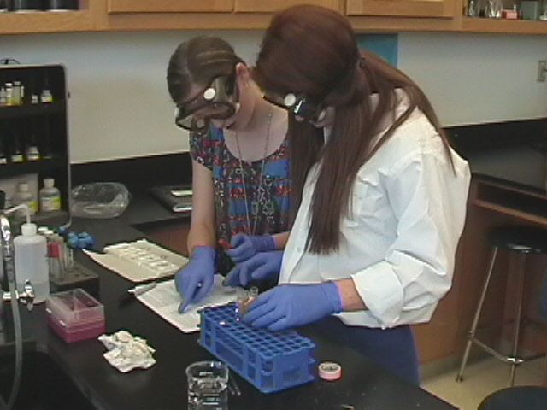
So, they made a plan to conduct a series of tests, called serial dilutions and chemical tests on the soil before any acid was poured in the soil squares.
Chemical Tests
Serial Dilutions

Slide 10
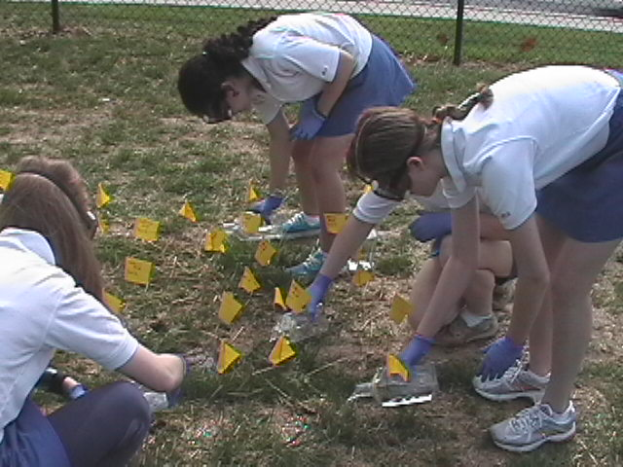
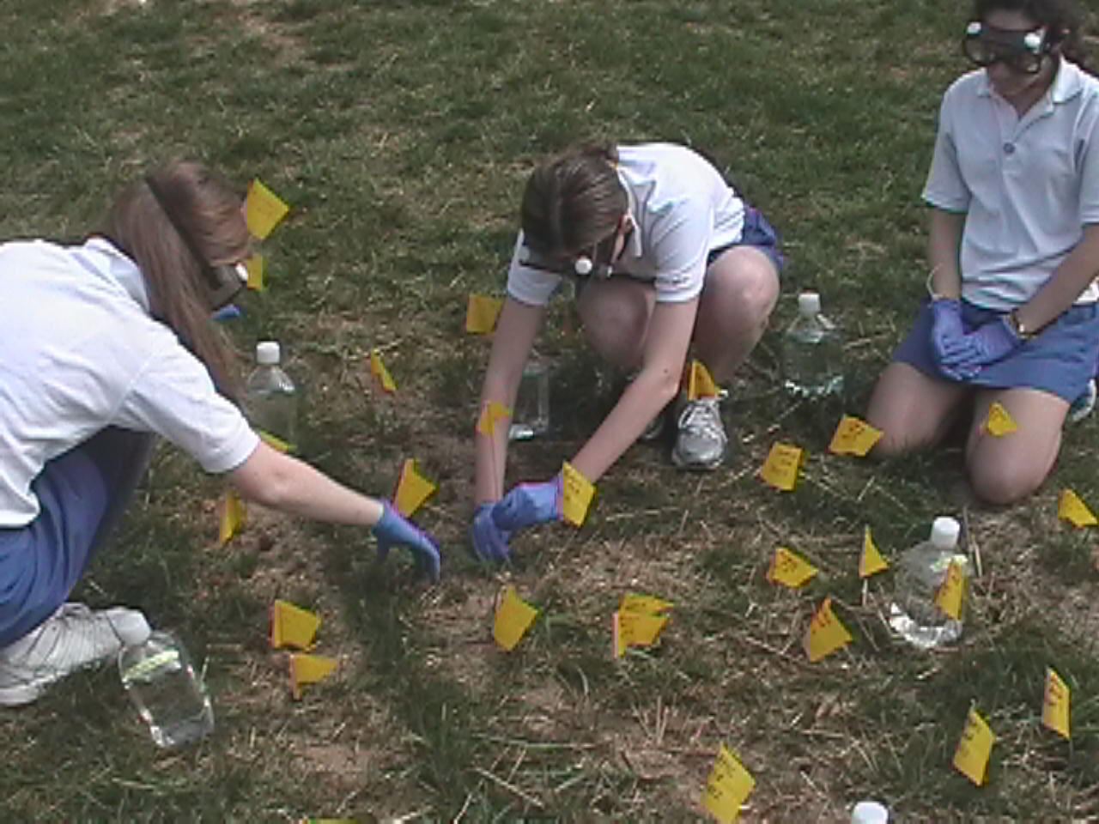
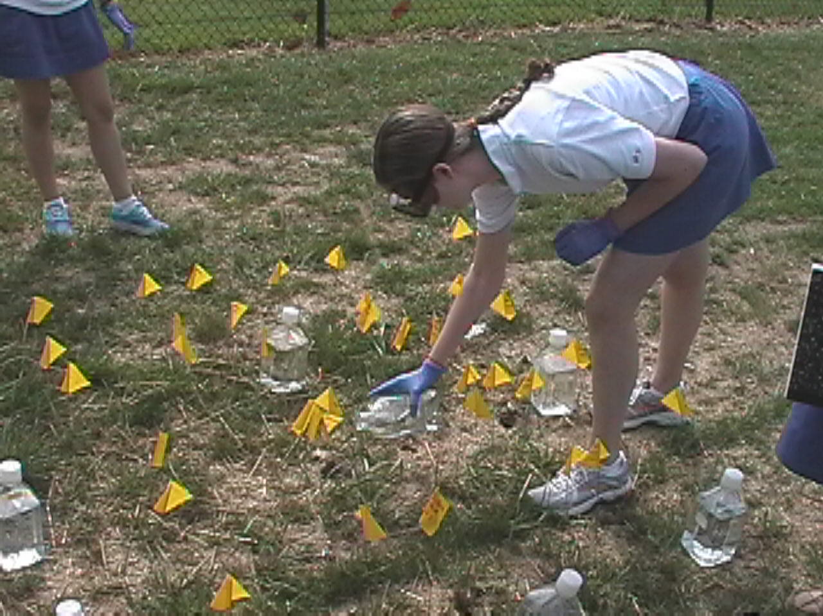
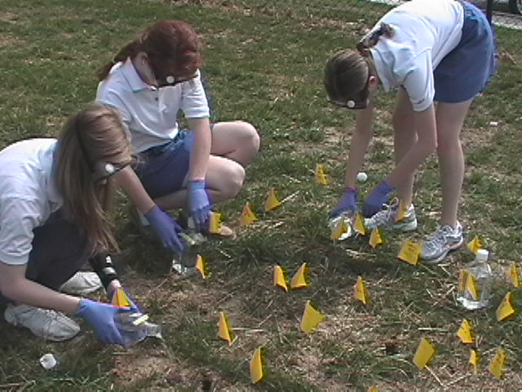
Then, the ace team RPCS got to go outside and pour sulfuric acid, nitric acid, and water on the soil squares. Luckily, Baby Bobby told every member to be careful because the acid was very harmful, and they were all fine!!!!

Slide 11
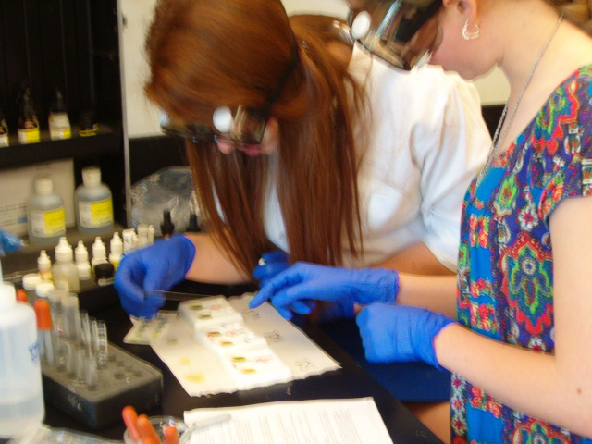
They then conducted the serial dilutions and the chemical tests on the soil after the acid was poured on the soil squares.
Serial Dilutions
Chemical Tests

Slide 12
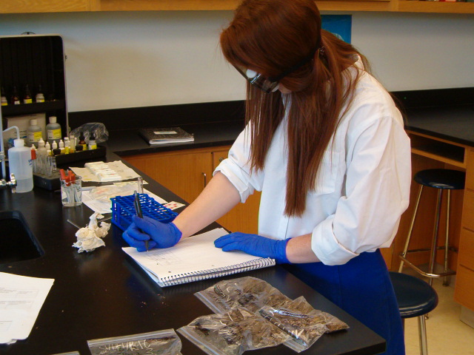
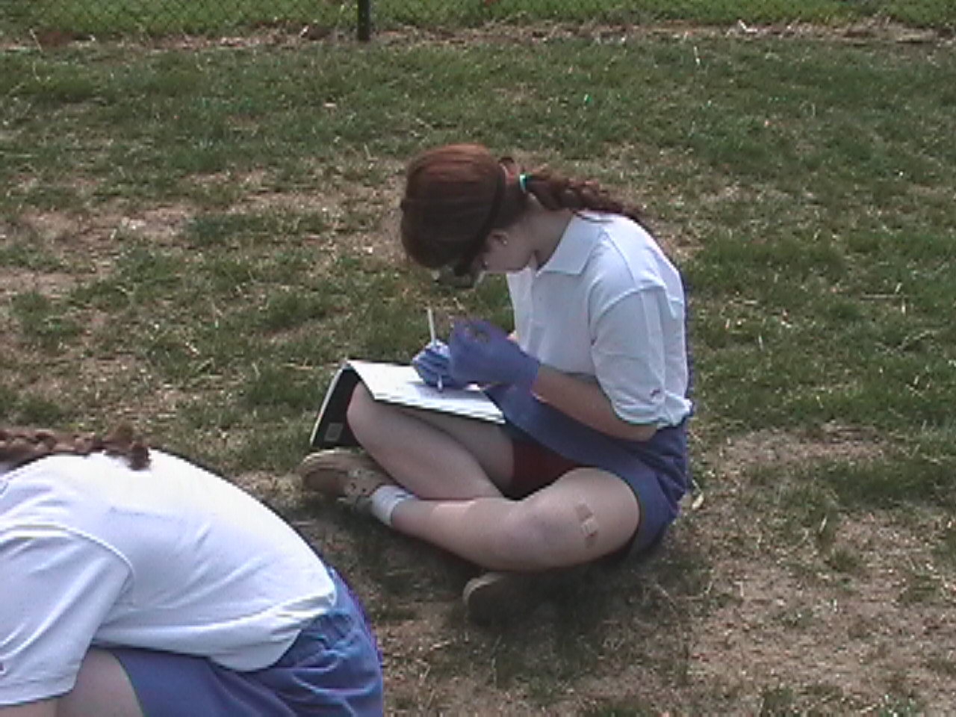
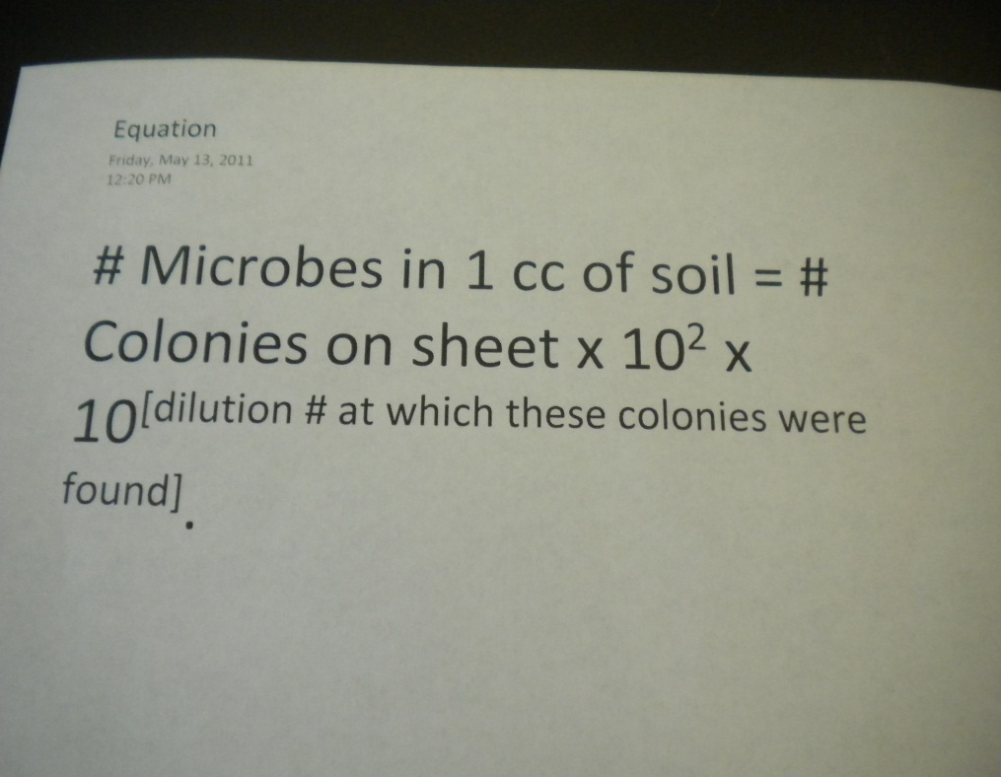
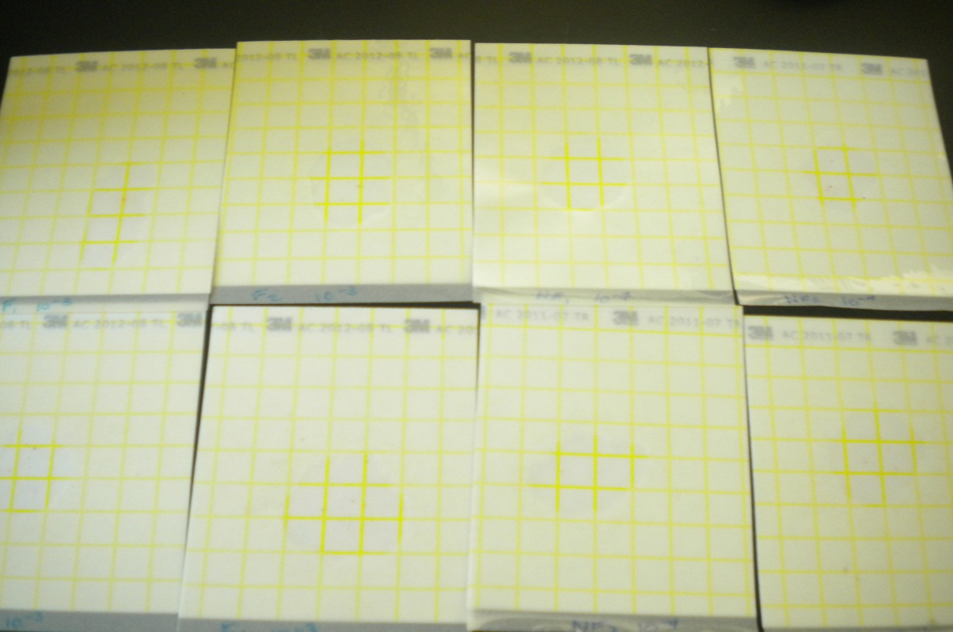
Then, they collected
all of their data!!!!

Slide 13
They then put all of their data into graphs. This enabled them to come to conclusions about their data and experiment.

Slide 14
Mama Margaret
Papa Peter
Very much so! Now that they have gathered this data, they are planning to move forward and find what the factor is that is hurting our soil. I'm excited!
Indeed!!!!!!
Mine as well! All of their data pointed towards water being toxic, but we all know that isn't true. So they must have thought that our soil was already in bad shape before they tested and that the acid rain wasn't truly hurting us in their experiment.
Wait, there's more! Their scatter plot shows that as the pH levels become more neutral, the bacteria number increases. This tells us that this data is happening in the real world.
They don't know but they found that nitric acid killed our species the most, water killed our species the second most, and strangely, sulfuric acid helped our species!!
HYPOTHESIS WAS WRONG!!!!!
No. Dude, what happened?
What?!?!?!
Oh, no! What is it?
Whoa dude, you just blew my nucleus!
I am too! This could save us!
This is really cool.
Whoa……
They found out that there is already something negatively affecting our soil.
Oh, Larry. Did you hear what happened to the ace team?
They proved their hypothesis wrong! And guess what?!
Lovable Larry
Baby Bobby

Slide 15
Mama Margaret
Papa Peter
Baby Bobby
Baby Bobby and his parents lived happily from then on! They could not wait until the ace team RPCS would find out more information about acid rain, pH, and bacteria!

Slide 16
Pictures Cited
23 May 2011. <http://www.google.com/imgres?imgurl=http://thumb1.shutterstock.com/thumb_small/615067/615067,1281361626,2/stock-vector-purple-cartoon-bacteria-character-58715494.jpg&imgrefurl=http://www.shutterstock.com/cat.mhtml%3Fsafesearch%3D1%26search_type%3Dsimilar%26similar_photo_id%3D50426602&usg=__IF1EttBRTEKTZgM0LPqhILxmxjI=&h=100&w=113&sz=5&hl=en&start=82&zoom=1&tbnid=e7ARgzMSGSNBAM:&tbnh=80&tbnw=90&ei=P_7aTZvVApDTgQfI4o1Y&prev=/search%3Fq%3DCartoon%2Bof%2Bbacteria%26um%3D1%26hl%3Den%26sa%3DX%26rlz%3D1R2SKPT_enUS400%26biw%3D1259%26bih%3D594%26tbm%3Disch0%2C1700&um=1&itbs=1&iact=hc&vpx=158&vpy=324&dur=814&hovh=80&hovw=90&tx=102&ty=32&sqi=2&page=5&ndsp=21&ved=1t:429,r:0,s:82&biw=1259&bih=594>
23 May 2011. <http://www.google.com/imgres?imgurl=http://sp.rpcs.org/rpcsweb/home/upperschool/sga/website%2520graphics/rpcs.jpg&imgrefurl=http://sp.rpcs.org/rpcsweb/home/upperschool/sga/default.aspx&usg=__i5wfUlJLT8-Tm61jPZr4DCvLmI8=&h=1536&w=2048&sz=1157&hl=en&start=0&zoom=1&tbnid=LtGlmkV35VgqZM:&tbnh=132&tbnw=176&ei=WADbTZGcH9GdgQfDvun3Dw&prev=/search%3Fq%3Droland%2Bpark%2Bcountry%2Bschool%26um%3D1%26hl%3Den%26sa%3DN%26rlz%3D1R2SKPT_enUS400%26biw%3D1276%26bih%3D594%26tbm%3Disch&um=1&itbs=1&iact=rc&dur=194&sqi=2&page=1&ndsp=18&ved=1t:429,r:0,s:0&tx=87&ty=50>
23 May 2011. <http://www.google.com/imgres?imgurl=http://www.salmonellablog.com/biology_lab.jpg&imgrefurl=http://www.salmonellablog.com/2006/08/&usg=__9RqNIx7REyeSyJEhb6FPZZ54VPM=&h=300&w=400&sz=25&hl=en&start=0&zoom=1&tbnid=NdvhR4e2v2_tRM:&tbnh=142&tbnw=189&ei=rQfbTaHYPIrYgQfa37nwDw&prev=/search%3Fq%3Dbiology%2Blab%2Broom%26um%3D1%26hl%3Den%26sa%3DN%26rlz%3D1R2SKPT_enUS400%26biw%3D1259%26bih%3D594%26tbm%3Disch&um=1&itbs=1&iact=hc&vpx=131&vpy=242&dur=424&hovh=194&hovw=259&tx=178&ty=66&sqi=2&page=1&ndsp=18&ved=1t:429,r:6,s:0>
23 May 2011. <http://www.google.com/imgres?imgurl=http://www.hubtesting.net/yahoo_site_admin/assets/images/bacteria.94120838_std.jpg&imgrefurl=http://www.hubtesting.net/&usg=__tfvLk_Ef7llzOHKxa8nItOvaxJo=&h=441&w=560&sz=67&hl=en&start=0&zoom=1&tbnid=6repzbuF4HcZiM:&tbnh=131&tbnw=156&ei=vxLbTb34LoregQeH_TE&prev=/search%3Fq%3Dbacteria%26um%3D1%26hl%3Den%26sa%3DN%26rlz%3D1R2SKPT_enUS400%26biw%3D1259%26bih%3D594%26tbm%3Disch&um=1&itbs=1&iact=hc&vpx=667&vpy=115&dur=2783&hovh=199&hovw=253&tx=102&ty=72&sqi=2&page=1&ndsp=20&ved=1t:429,r:4,s:0>

Slide 17
Pictures Cited Continued
23 May 2011. <http://www.google.com/imgres?imgurl=http://www.planetnatural.com/planetnatural/images/soil-ph.jpg&imgrefurl=http://www.planetnatural.com/site/xdpy/kb/soil-ph.html&usg=__xrbGGXE_BriAtUs1YhYLYe8fULk=&h=165&w=210&sz=9&hl=en&start=0&zoom=1&tbnid=xfQZIwxoWJuJJM:&tbnh=118&tbnw=155&ei=7hvbTeK8NOHt0gGmn525Dw&prev=/search%3Fq%3Dsoil%2BpH%26um%3D1%26hl%3Den%26rlz%3D1R2SKPT_enUS400%26biw%3D1259%26bih%3D594%26tbm%3Disch&um=1&itbs=1&iact=rc&dur=80&sqi=2&page=1&ndsp=20&ved=1t:429,r:1,s:0&tx=33&ty=31>
23 May 2011. <http://www.google.com/imgres?imgurl=http://biocitizen.org/wp-content/uploads/2009/12/Top-soil.jpg&imgrefurl=http://biocitizen.org/chernozem/top-soil&usg=__tsME_PgoL18Y9JFNi-IFCF0BKqc=&h=200&w=200&sz=7&hl=en&start=41&zoom=1&tbnid=nw7yVS9eHOJf5M:&tbnh=131&tbnw=144&ei=YhzbTc69JsH50gGq0IXPDw&prev=/search%3Fq%3Dsoil%26um%3D1%26hl%3Den%26sa%3DN%26rlz%3D1R2SKPT_enUS400%26biw%3D1259%26bih%3D594%26tbm%3Disch&um=1&itbs=1&iact=rc&sqi=2&page=3&ndsp=20&ved=1t:429,r:12,s:41&tx=88&ty=64>
23 May 2011. <http://www.google.com/imgres?imgurl=http://www.rocbike.com/wp-content/uploads/2008/08/rain.jpg&imgrefurl=http://www.rocbike.com/tag/rain/&usg=__6kviQTCOAjpisB3qF6_ts91w89o=&h=338&w=506&sz=77&hl=en&start=0&zoom=1&tbnid=wrKsL4LcsRlcWM:&tbnh=120&tbnw=167&ei=Sx3bTff3Oo3egQextZHoDw&prev=/search%3Fq%3Drain%26hl%3Den%26gbv%3D2%26biw%3D1259%26bih%3D594%26tbm%3Disch&itbs=1&iact=hc&vpx=112&vpy=118&dur=222&hovh=183&hovw=275&tx=157&ty=63&sqi=2&page=1&ndsp=20&ved=1t:429,r:0,s:0>
24 May 2011. <http://www.google.com/imgres?imgurl=http://whyiswhoiswhatare.com/wp-content/uploads/2008/07/why-is-soil-so-important.jpg&imgrefurl=http://whyiswhoiswhatare.com/why-is-soil-so-important&usg=__PwEwilAD7_uF4MRAAhULsN3apyA=&h=512&w=512&sz=163&hl=en&start=0&zoom=1&tbnid=XRUWNRziVxQB1M:&tbnh=141&tbnw=139&ei=mjTcTdD3HtOSgQfqyZjoDw&prev=/search%3Fq%3Dsoil%2Bin%2Bground%26um%3D1%26hl%3Den%26rlz%3D1R2SKPT_enUS400%26biw%3D1259%26bih%3D594%26tbm%3Disch&um=1&itbs=1&iact=rc&dur=125&sqi=2&page=1&ndsp=18&ved=1t:429,r:1,s:0&tx=19&ty=22>
23 and 24 May 2011. <Clip Art pictures.>
5-10 May 2011. <Pictures taken by Mr. Brock.>
23 May 2011. <Pictures of group mates’ headshots.>

