Slide 1
A Day In The Life of Pamela the Protozoa
BY: Emily Joffe, Lauren Zollicoffer, Cailin Gore, Lindsey Feinstein

Slide 2
ONCE UPON A TIME….

Slide 3
There was Pamela the Protozoan… she had two other friends Paige and Paisley
Pamela
Paige
Paisley

Slide 4
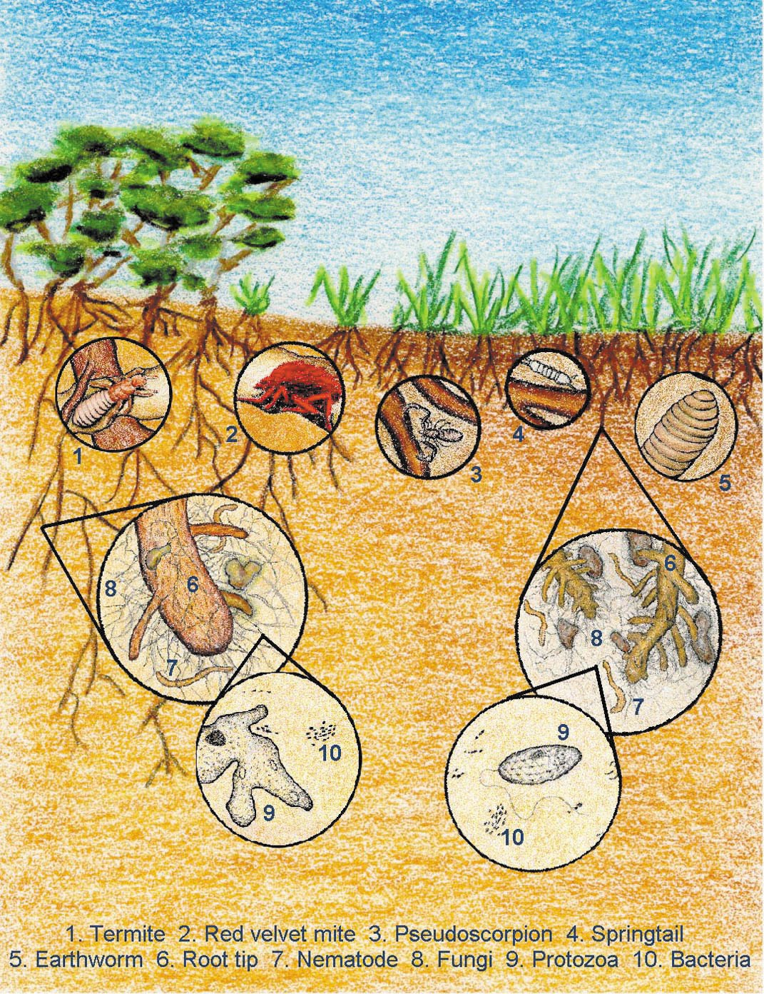
Background: Protozoa
Soil microorganisms
Benefit the growth of plants and the health of the larger ecosystem
Unicellular eukaryotes
Live in water-filled pores
Reproduce by binary fission
Located near the roots of plants
Allow plants to absorb additional nutrients to perform daily functions
Notes:
More background

Slide 5
Protozoa Function in Environment
Protozoa consume bacteria
Protozoa control the decomposition rate and maintain the nitrogen cycle in the soil

Slide 6
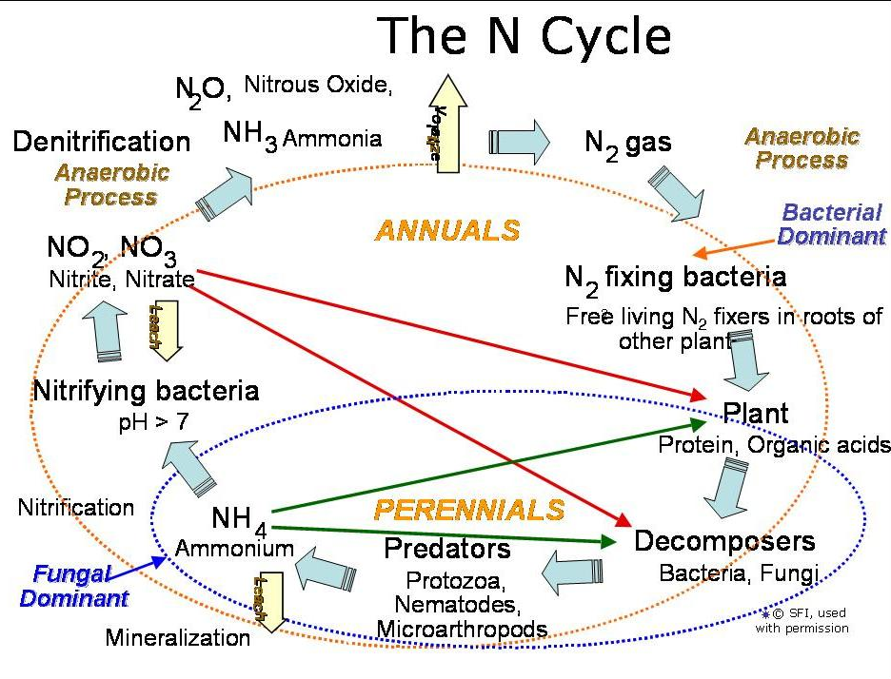
Nitrogen Cycle

Slide 7
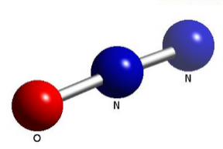


The Effect of Greenhouse Gases
Carbon dioxide is a greenhouse gas that comes from fossil fuels
Nitrous oxide, sulfur dioxide, and menthol gas come from the burning of fuel as well
For every gallon of gas burned, pounds of these gases are produced and leaked into the atmosphere
Moisture in the air increases effects of chemicals
When nitrous oxide and sulfur dioxide from the exhaust mix with water and oxygen in the atmosphere, it produces ACID RAIN

Slide 8

How Pollution Affects Soil
When too much car exhaust is close to the water pores, the soil becomes more acidic
If this happens the pH level of the soil will decrease
pH measures the acidity or basicity of the substance

Slide 9
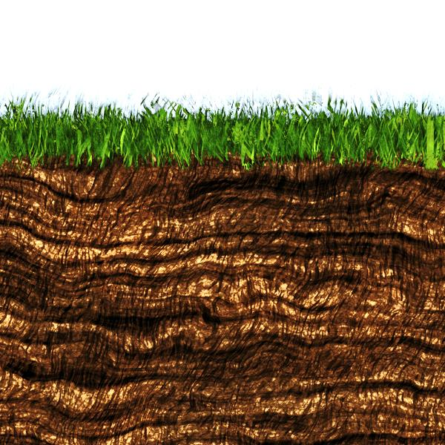
While Pamela was having a conversation with her friends she realized, there was something above her head about to capture her and her friends.
OMG! What’s happening
What is that above your head Paisley?

Slide 10
Paisley was then captured by the soil extractor abandoning her friends for the humans
According my phone’s GPS I am N: 39.35817 degrees and W: 076.63554 degrees
Hey Paige, where are you?
I hope what happened to Paisley doesn’t happen to us!
Me too!

Slide 11

Soon, Pamela then realizes she is also being taken away by the humans and immediately calls Paige.
No! Its happening to me Paige! What ever happened to Paisley is happening to me! Help!!!
RING! RING! RING!
NO! Pamela!!
Hello? Are you ok Pamela?

Slide 12
Paige thought….
What do I do now?
I’m the only one left. The humans can’t take me away!

Slide 13
Paige then noticed the humans were also taking her away
No!
It’s happening to me too!
Bye home! I will miss you!

Slide 14
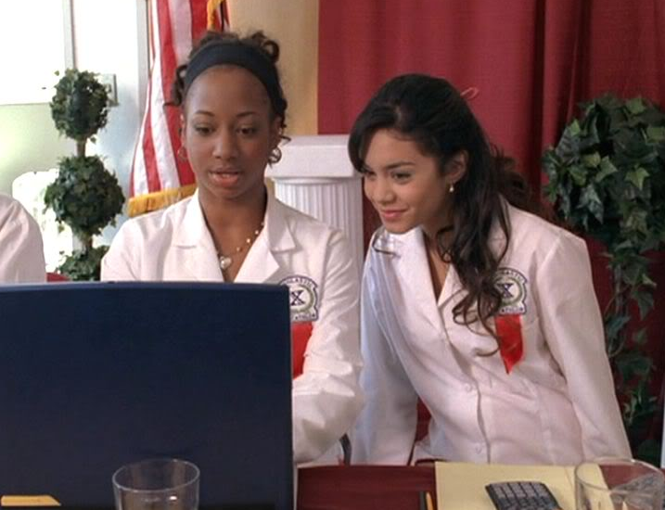
When all the protozoans were captured by the humans, they were taken into the humans secret testing lab.

Slide 15
All the protozoans were reunited in the human’s science lab; but, they didn’t know what would soon await them in 24 hours…
Me too!
I missed you guys!
Probably later or tomorrow
Me three!
I don’t know
Where are the humans?
When will they be back?

Slide 16
After all the protozoans went through the protozoa extraction process, they met up with each other at the end.

Slide 17
When the protozoans started to discuss what happened, they realized it was the process of protozoa extraction.
I think we just went through the process of protozoa extraction
I don’t understand what just happened… will someone explain?
What just happened to us ?

Slide 18
Paisley then explained what really happened…
Once the soil dried after 24 hours, we were placed into a cup with 1mm nylon mesh, the soil was then sifted to 9.8 grams. Then we were placed into a clean petri-dish
But I think someone added distilled water to my petri dish
Notes:
Separate into different slides

Slide 19

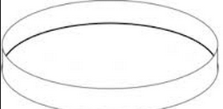
Oh! Your right…. That’s the next step the humans did to saturate the soil. They added 20 mL of distilled water.
20 mL

Slide 20
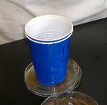
But we couldn’t communicate for 7 hours…?
I know, the soil needed to sit for 7 hours in order for the extraction to work. Then the humans made a tool called a Uhlig extractor.

Slide 21

But then I was placed into another petri dish with clean distilled water.
yes you’re correct… they added 30 mL of distilled water to the bottom of the petri dish. Then we were scooped into the uhlig extractor and sat for 24 hours.
Oh… That’s why I thought I was falling!

Slide 22
But paisley, why were we so cold?
Then we had to be filtered one more time
Because we were put into a refrigerator.

Slide 23
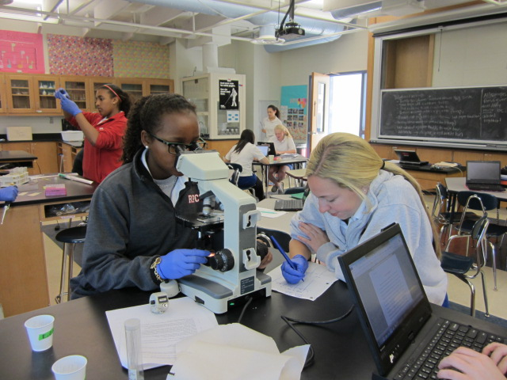
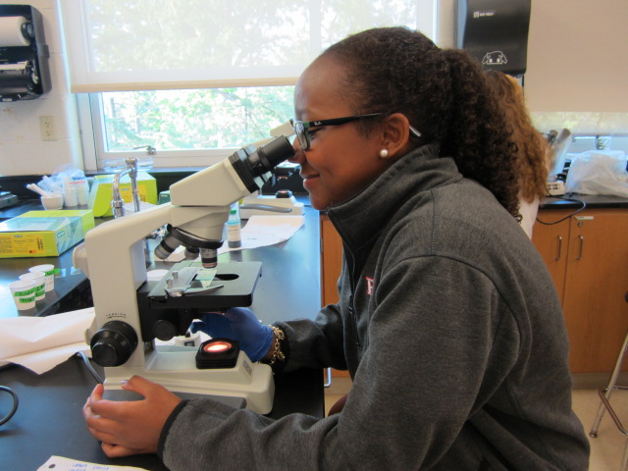
The humans were counting the total number of protozoa on a microscope slide
I felt the humans staring at me though

Slide 24
After all the data was collected…
Population Density of Protozoa in the Soil based on Proximity to Car Exhaust
Average Population Density of Protozoa Based on Proximity to Car Exhaust
Soil Sample | # of protozoa in 1 gram of soil
Plot A Trial 1 | 487836
Plot B Trial 1 | 586928
Plot C Trial 1 | 46115
Plot A Trial 2 | 570159
Plot B Trial 2 | 444388
Plot C Trial 2 | 515658
Plot A Trial 3 | 415042
Plot B Trial 3 | 301848
Plot C Trial 3 | 364734
Plot | Average number of protozoa in 1 gram of soil
A | 491012
B | 444388
C | 308835

Slide 25
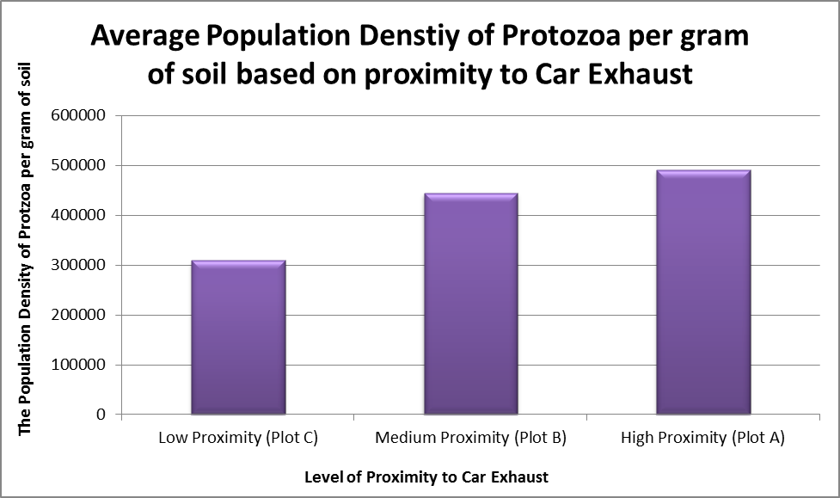
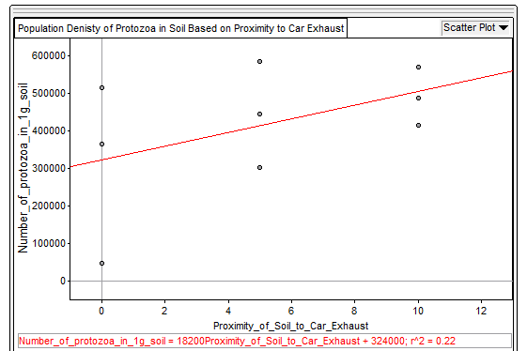
Graphs
Bar Graph
Scatter Plot

Slide 26
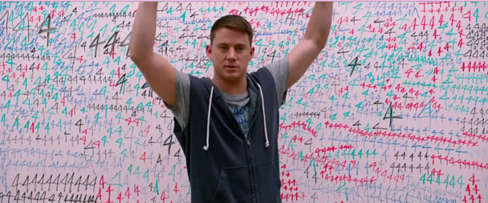
Conclusions
Our hypothesis was proven wrong in this experiment
The higher the car exhaust exposure, the population of protozoa increased
Plot A (the highest exposure) = 491,012 protozoa in one gram of soil
Plot B (the medium exposure) = 444,388 protozoa in one gram of soil
Plot C (the lowest exposure) = 308,835 protozoa in one gram of soil

Slide 27
Bibliography
http://ladygeekgirl.files.wordpress.com/2013/10/gabriella-and-taylor.jpg
https://www.youtube.com/watch?v=_3nfrGdVcv0
http://4.bp.blogspot.com/_qudJsVkP_bs/TAkXctf-8QI/AAAAAAAABEc/cSr4-Lz5rU8/s1600/soil+biota.bmp
http://4206e9.medialib.glogster.com/media/316facb8d996b20cb42c2d92202b161cdecb505d1f0b120c1c5350c693551672/red-cartoon-car-with-exhaust-0071-1006-2115-1412-smu.jpg
http://94.136.40.103/~newadenergy.com/procurement/wp-content/uploads/2014/03/CO2-in-clouds.jpg
http://lh3.ggpht.com/_lhmnlBFNfko/SCJfYI1EiSI/AAAAAAAAEVQ/_ue4hTT_2pk/Nitrous+Oxide+molecule.jpg
http://www.belgraviacentre.com/wp-content/uploads/2011/03/Acid-Rain-Bald-Man.gi
http://www.clker.com/cliparts/N/O/C/B/D/i/agar-plate-md.pngf
http://essre.rpcs.org/2009/OXYGEN/scraping%20soil%20sample%20into%20ulig.JPG
http://st.depositphotos.com/1742172/1958/v/950/depositphotos_19584675-Alarm-clock-cartoon.jpg
http://questgarden.com/84/74/3/100729110146/images/0060-0910-2412-1259_Young_Girl_Looking_Through_A_Microscope_clipart_imageCutout.png
http://www.aidthoughts.org/wp-content/uploads/2013/11/jumpstreet.jpg

