Slide 1
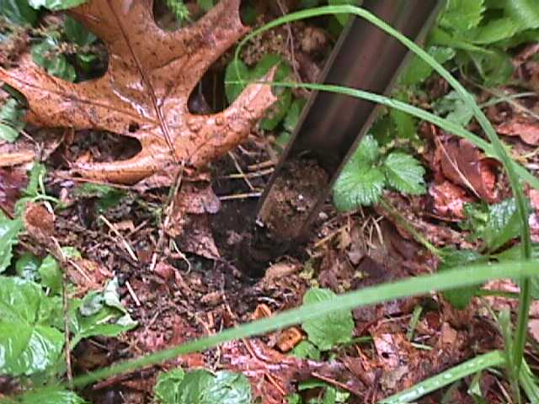
“The Little Things that Run the World”
Exploring the World of Microecology
By David L. Brock

Slide 2
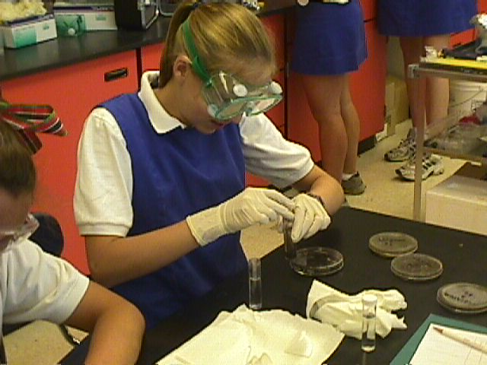
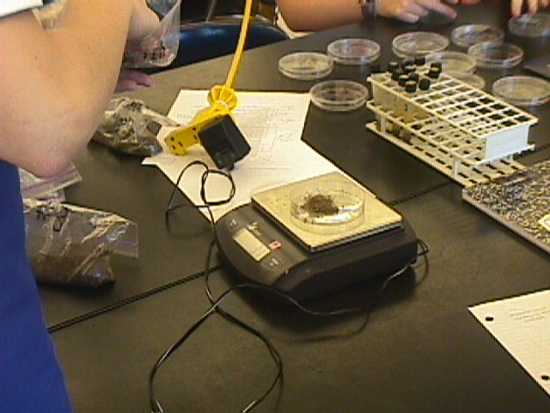
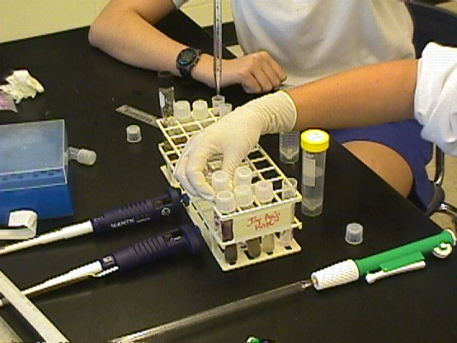
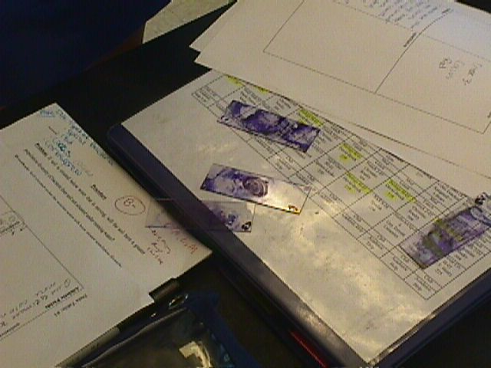
Extract, Dilute, Identify, Test

Slide 3
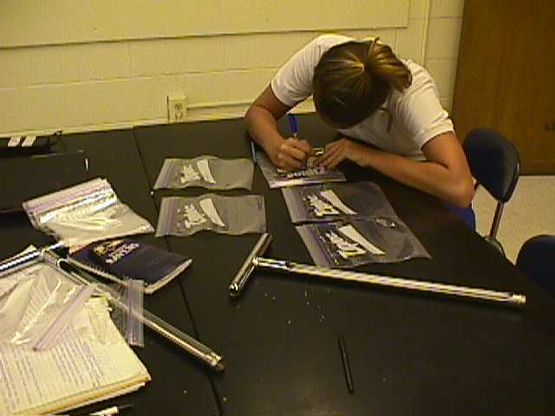
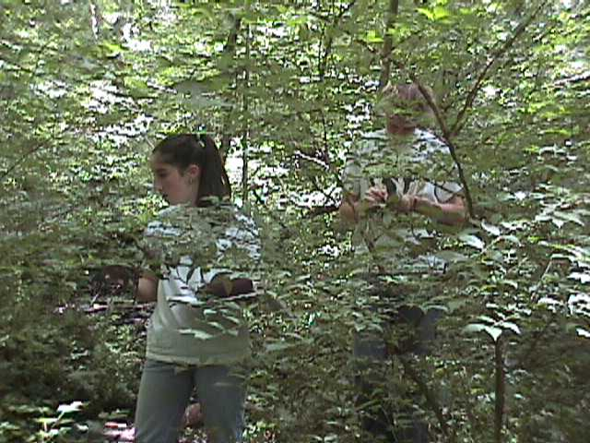
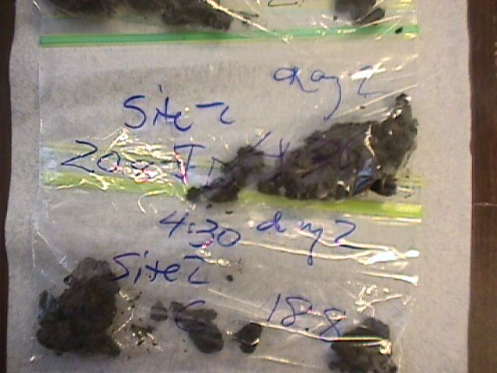
Sample Collecting
use soil cylinders 10-15 cm deep; keep in fresh plastic bags (don’t reuse to avoid contamination)
should collect min. of 3 samples from each location
make sure to collect all samples on the same day & time
remember: soil is still “alive” in the plastic bag

Slide 4
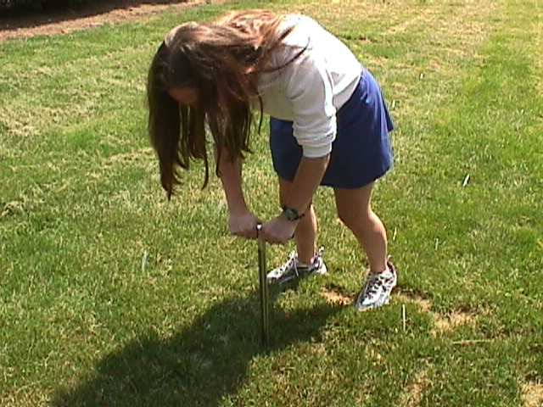
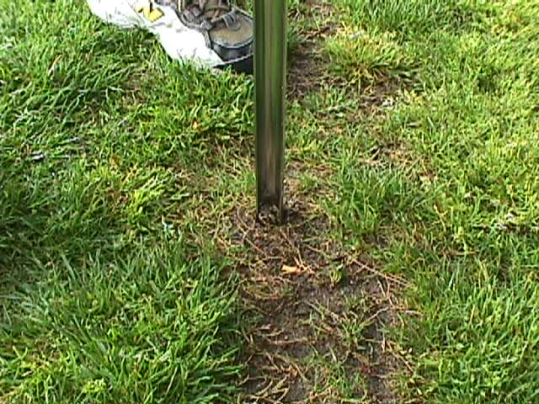
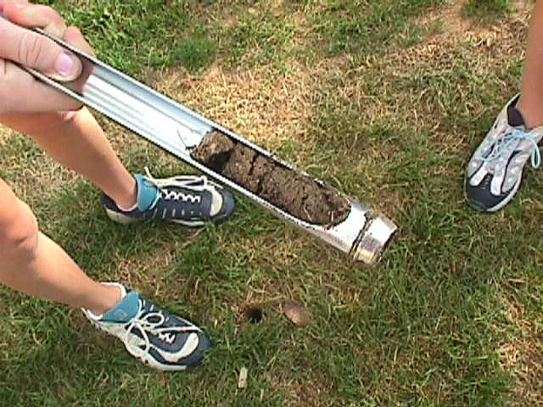
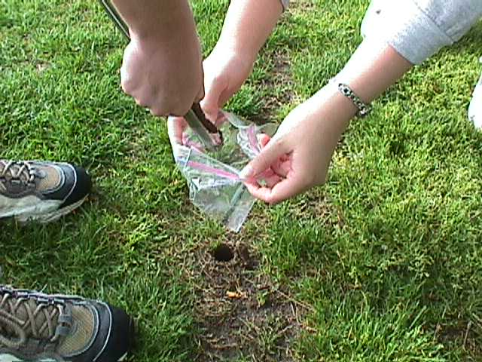

Slide 5
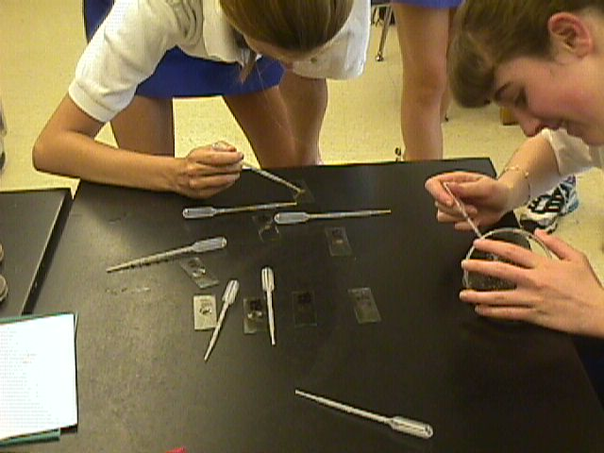
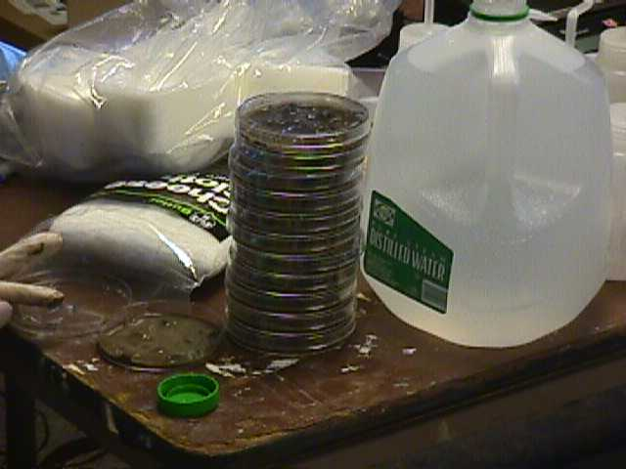
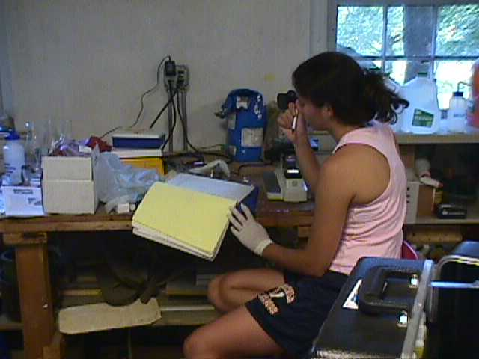
Protozoa Extraction
be sure to use distilled water and not tap water; but it does not need to be sterile
filter the Uhlig run-off a second time for improved viewing
methyl green is the preferred stain
to quantify: [(# per field of view at 40X) • (total ml of water used) • 747] ÷ (grams of sifted soil ) = # of protozoa per gram of soil

Slide 6
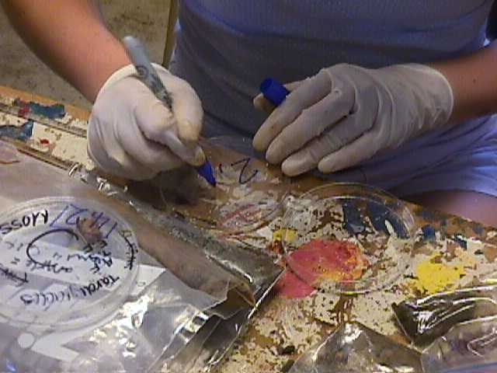
Step 1: collect and label clean petri dishes for each soil sample

Slide 7
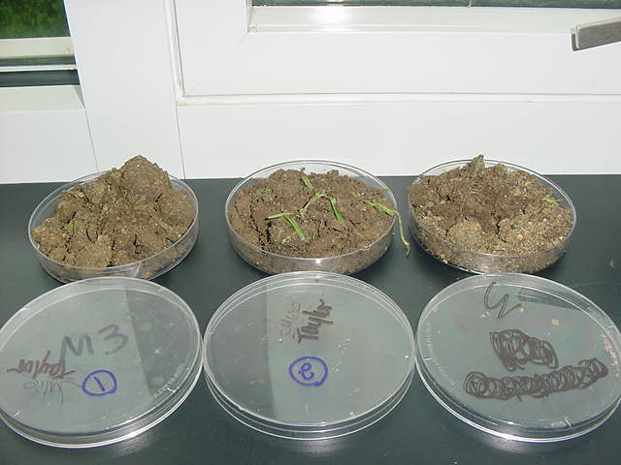
Step 2a: air dry soil sample for at least 24 hours

Slide 8
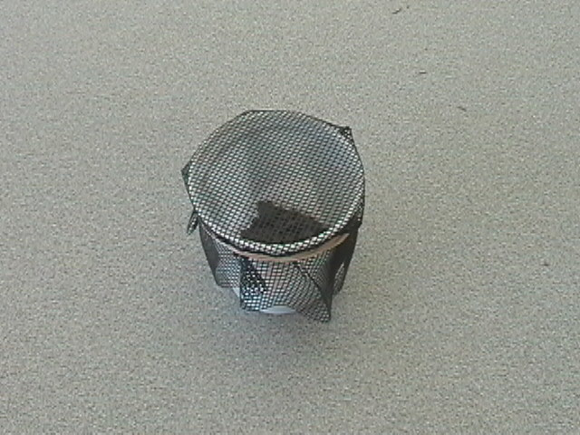
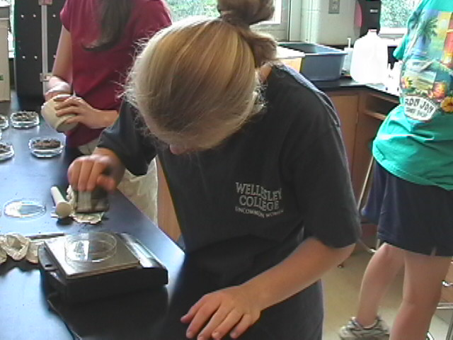
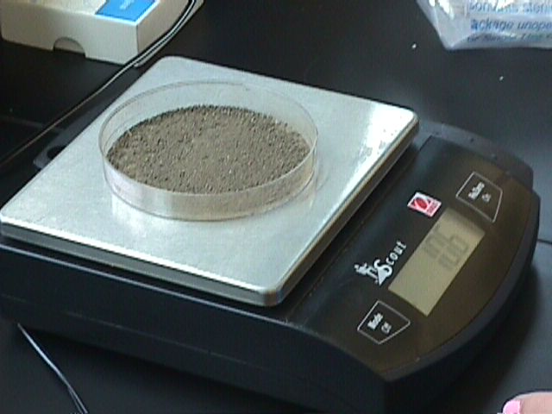
Step 2b: then put dried soil into a small cup and cover with a 1 mm² nylon mesh; sift 10 g into a clean petri dish

Slide 9
Step 3: saturate sample with 20 ml distilled water

Slide 10
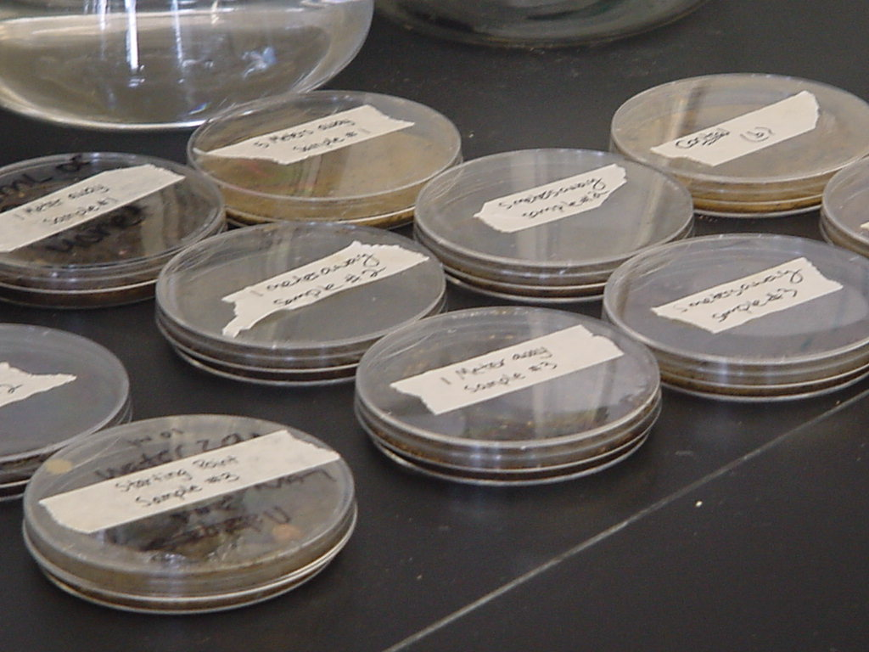
Step 4: allow sample(s) to sit for 7 hours at room temperature

Slide 11
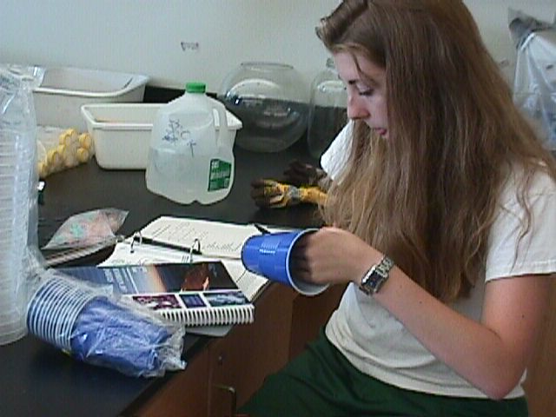
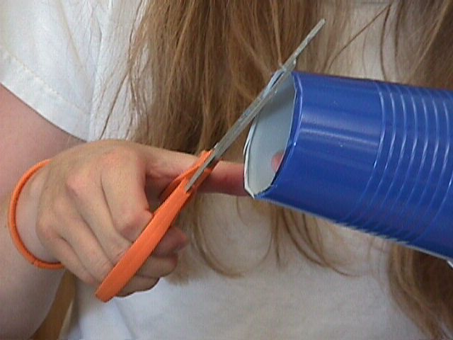
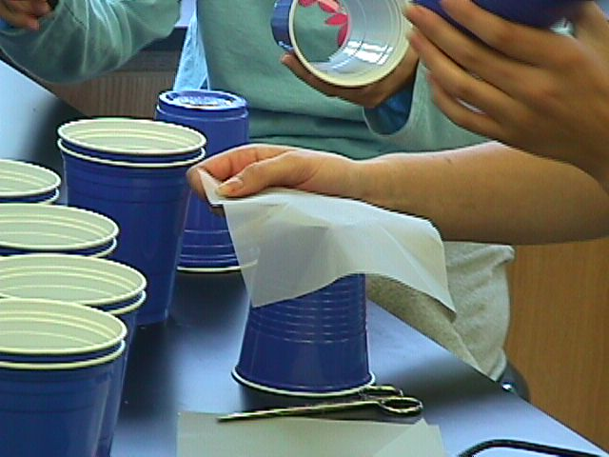
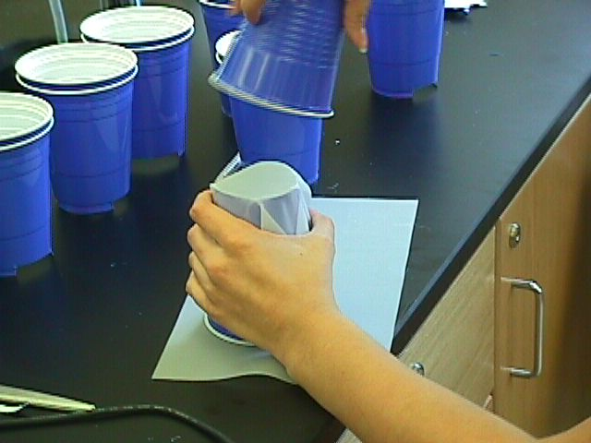
Step 5: make a modified Uhlig ciliate sandy sediment separator(s) out of plastic cups & 2 sheets of nylon bridal veil

Slide 12
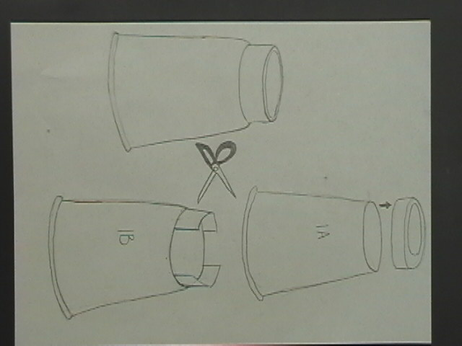

Slide 13
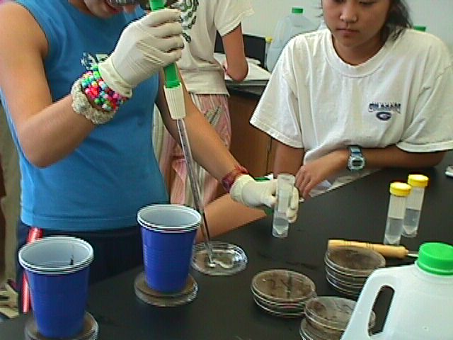
Step 6: add 30 ml of distilled water to the bottom of a 100x15 mm petri dish

Slide 14
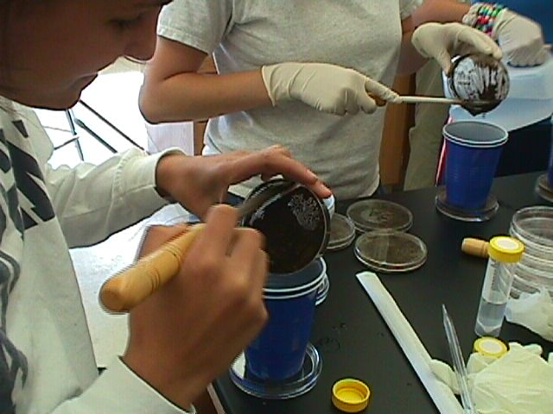
Step 7: place Uhlig extractor into petri dish & scoop the rehydrated soil sample into the extractor. Allow to filter for 24 hrs at room temp.

Slide 15
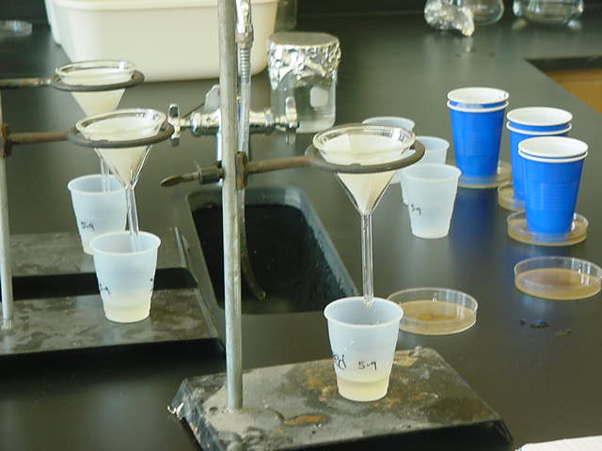
Step 8: filter the sample a second time using qualitative filter paper

Slide 16
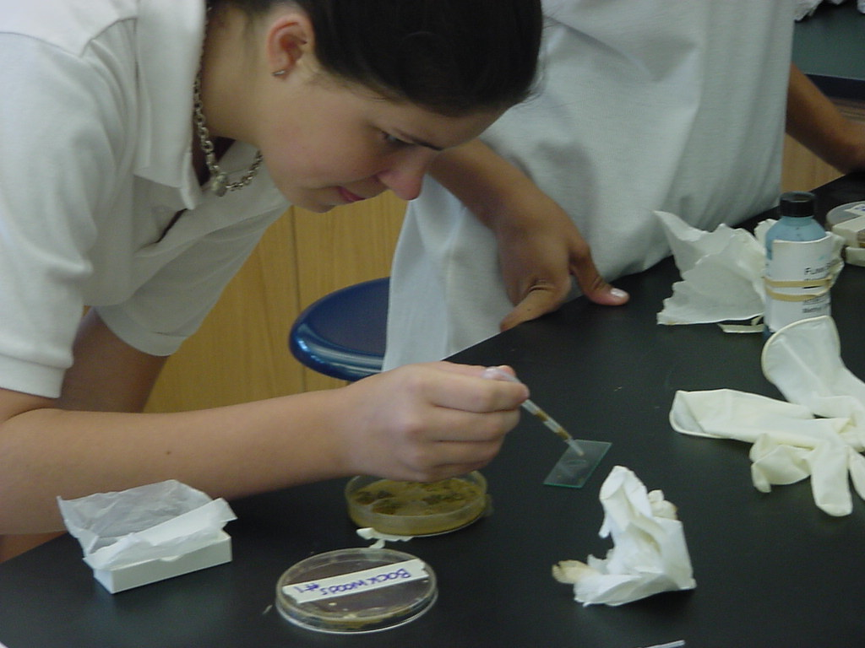
Step 9a: prepare microscope slides for viewing from the second filtrate

Slide 17
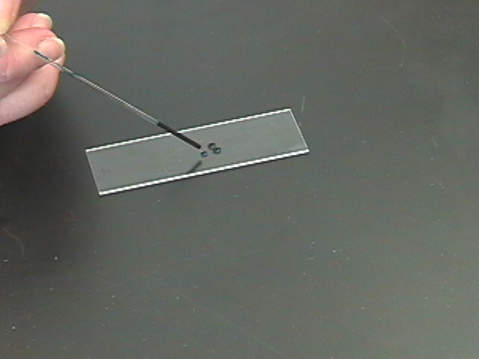
Step 9b: using a capillary tube, add methyl green dye to a microscope slide (1 ul = 1 drop from the tube)

Slide 18
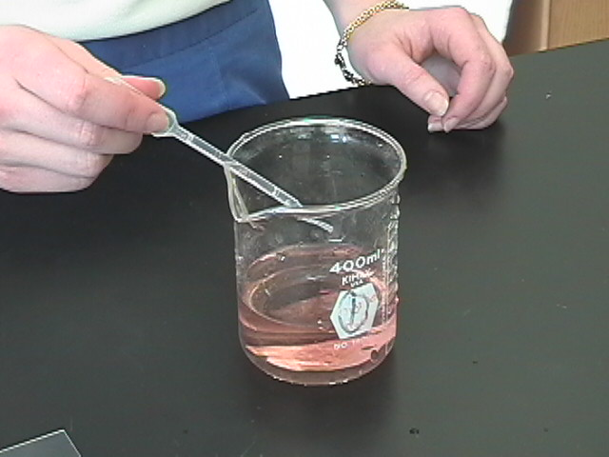
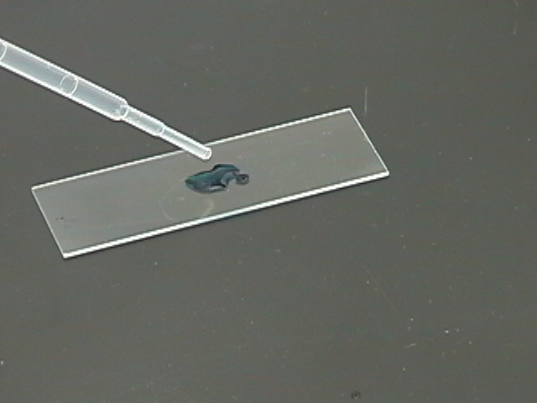
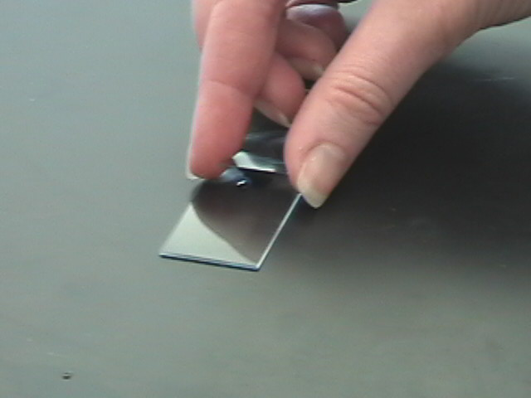
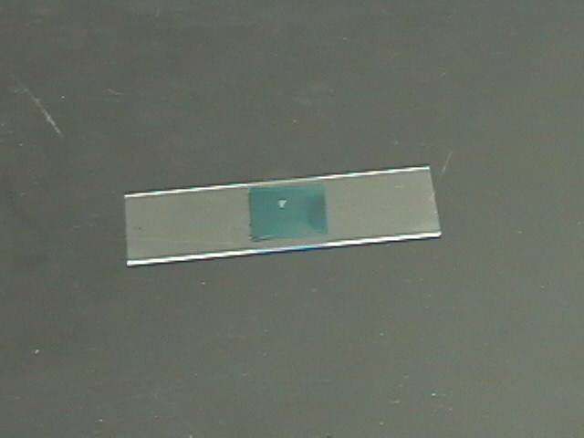
Step 9c: add 18 ul of the filtrate using a graduated Beral-type pipette (the first demarcation) and cover with an 18 x 18 mm² cover slip

Slide 19
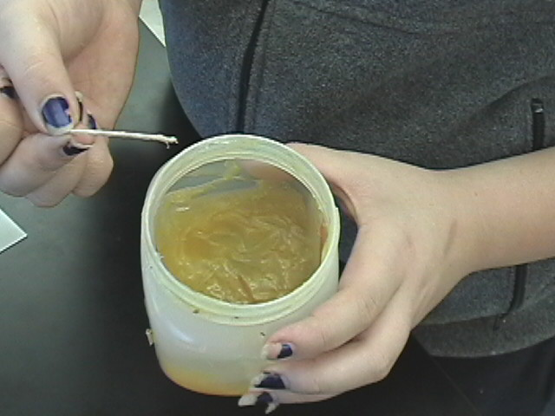
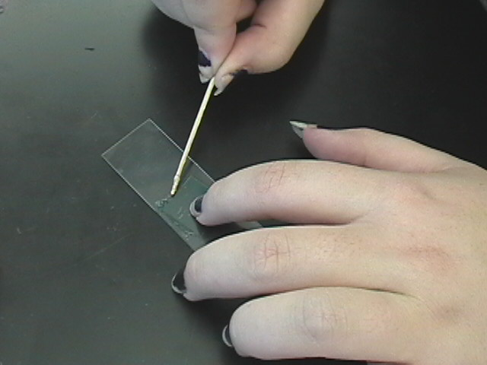
Step 10a: To prevent slides from drying out, dip the tip of a flat toothpick into petroleum jelly.
Step 10b: Then carefully streak the jelly along the edges of the cover slip to create a seal. Slide can now be observed at leisure up to 3 hours.

Slide 20
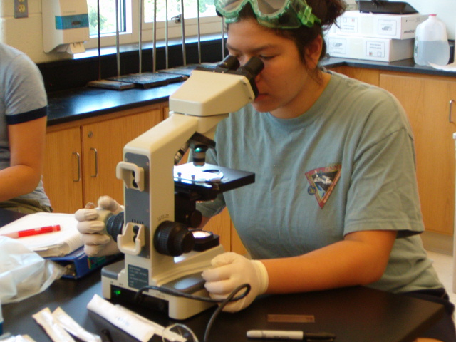
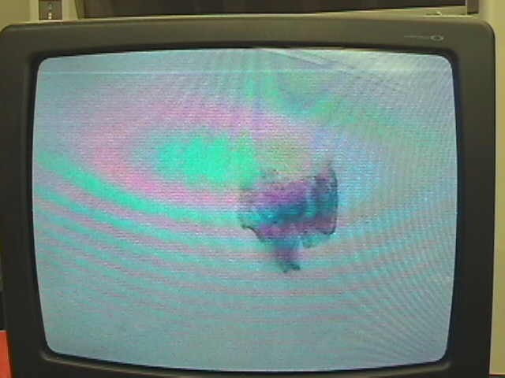
Determining Density vs. Diversity
For Density | For Diversity
Use 7 ul of dye & examine at 40X power and use the formula to determine estimate of population density per gram of soil. | Use 5 ul of dye & examine at 100X power for 9 fields of view to determine the proportion of each major type of protozoan.

Slide 21
Nine Fields of View
Types of Protozoa
Ciliophora
Shelled Amoeba
Mastigiophora
Sporozoa
Non-shelled Amoeba
Protozoa will appear translucent and slightly bluer than their surroundings. Make sure to adjust the light so that the maximum number of protozoa that are visible, and if needed use a counter.

Slide 22
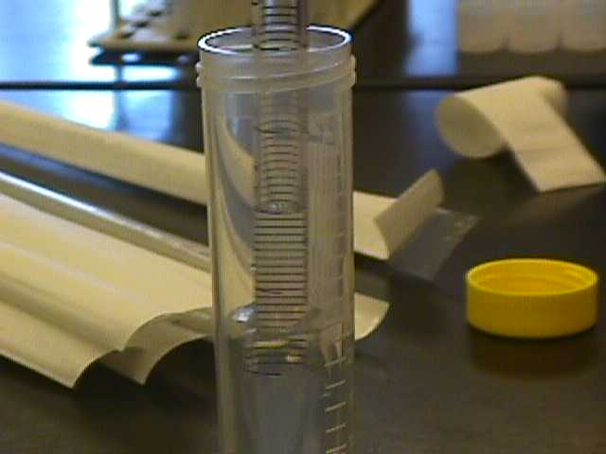
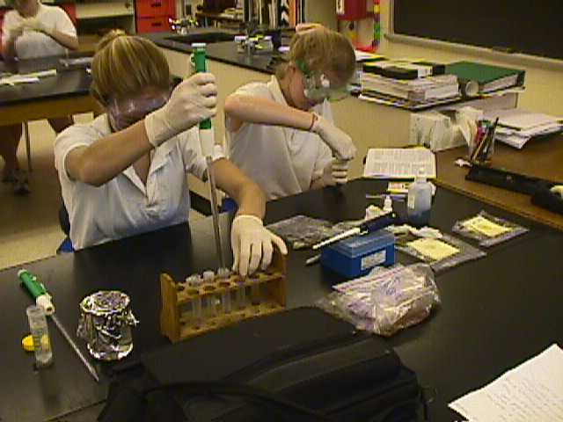
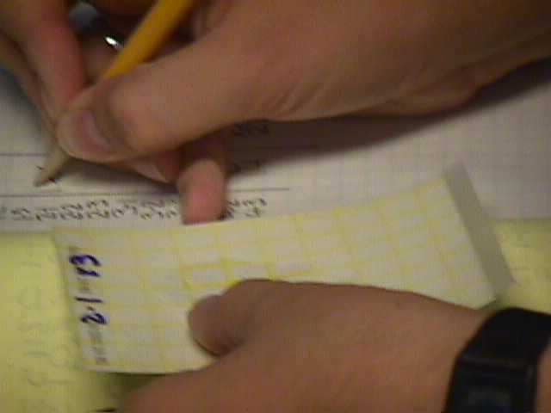
Serial Dilutions
use for bacteria, yeast, and mold counts in cfu/cm³; formula = # of colonies • 10² • 10 ^{|dilution factor|}
be sure to use sterile water (boiled & cooled works perfectly fine)
can reuse dilution tubes but clean thoroughly
easily adapted to “low-tech” with disposable graduated plastic droppers

Slide 23
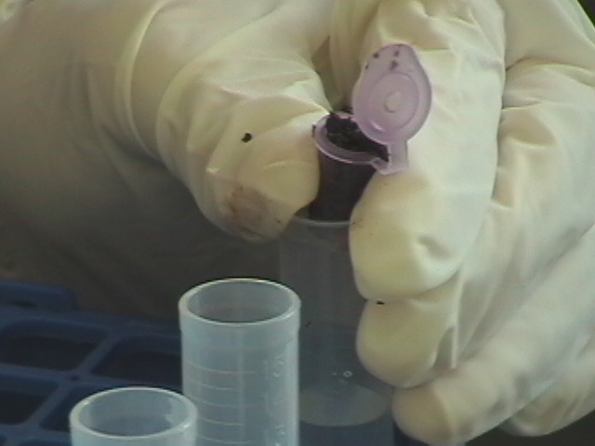
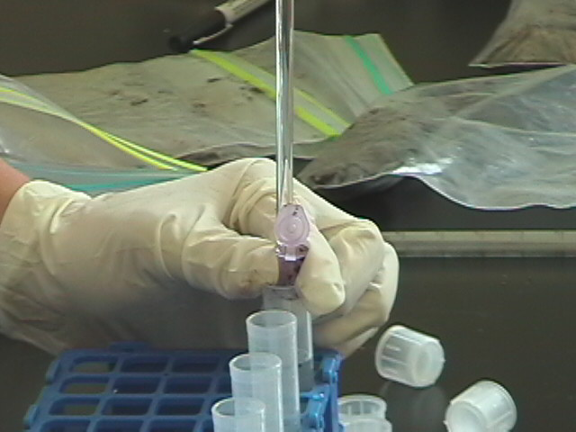
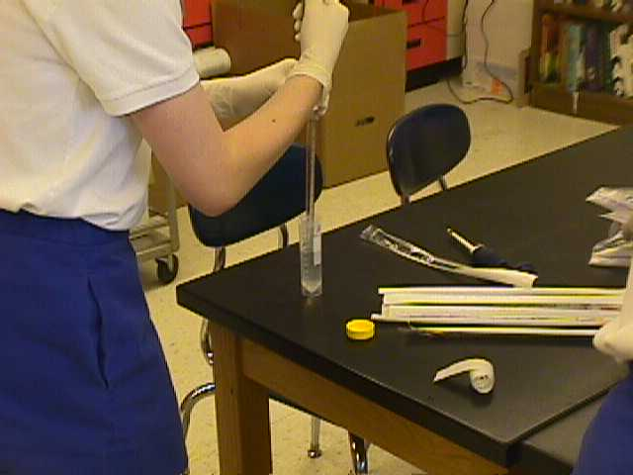
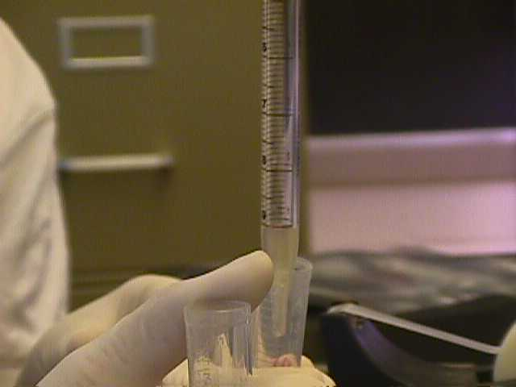
Step1: place a 1 cc sample of soil along with 10 ml of sterile water into a 15 ml transformation tube; cap, shake vigrously, and remove 1 ml of the soil/water mixture to add to a second transformation tube containing 9 ml of water.

Slide 24
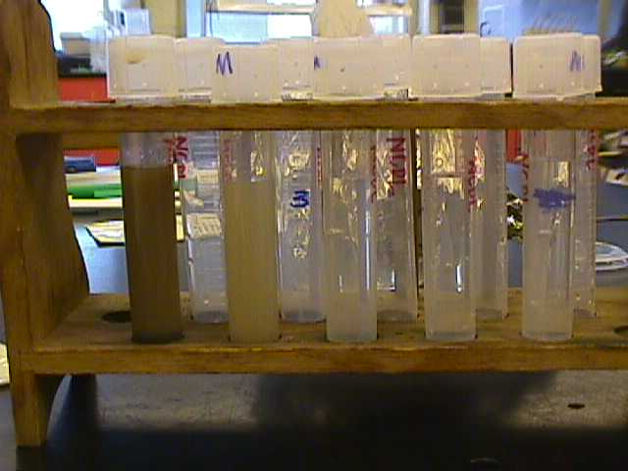
Step 2: repeat, placing 1 ml from 2nd tube into a 3rd tube, and so on until sample is diluted at least 4 times

Slide 25
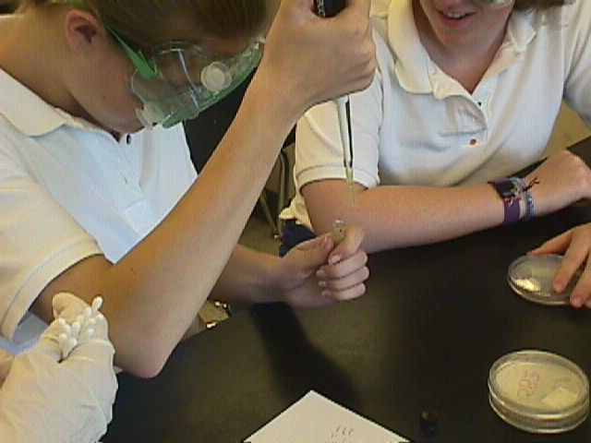
Step 3: remove a separate 100 µl sample from each dilution

Slide 26
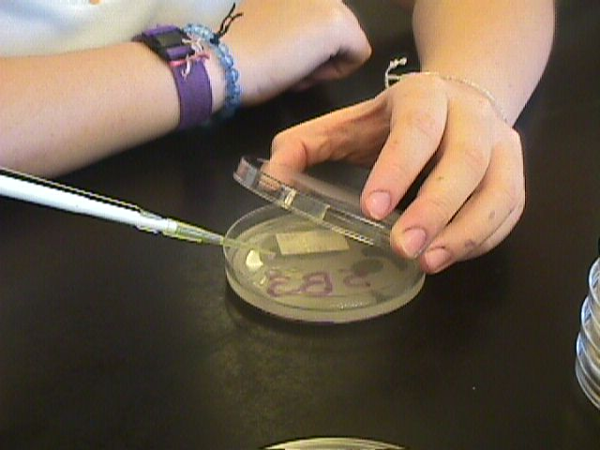
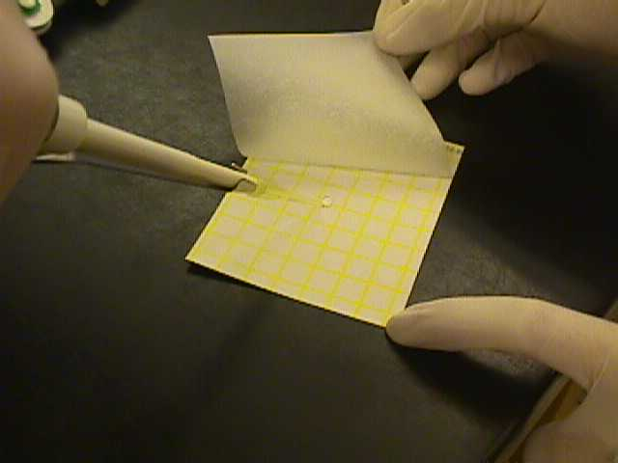
Step 4: plate the 100 µl samples with media & method of your choice

Slide 27
Step5: allow to grow at room temperature for 1-2 days

Slide 28
Step 6: examine each plate from a dilution series to find the ones with between 5 & 30 colonies; count the colonies on only those plates & use the formula to calculate the density of bacteria in the original cc of each soil sample

Slide 29
Chemical Testing
goggles & gloves!
always test at same time you sample microbe populations
pH, calcium, nitrate, & phosphate show nice relationships with protozoa as well as bacteria
active iron, aluminum, & manganese provide a good challenge for your better students

Slide 33
Acknowlegements
Kate Brockmeyer, Katie Loya, Lily MacKenty, Rebecca McWilliams, Lauren Sless, Mariel Torres, & Sophia Uddin
Institute for Ecosystem Studies
ReliaStar/Northern Life “Unsung Heroes” Program
Toshiba America Foundation
Human Capital Development, Inc
Paul F-Brandwein Institute
National Science Foundation
Gustav Ohaus Awards
Captain Planet Foundation, Inc.
Waksman Foundation for Microbiology
The Josowitz Family
Flinn Scientific
SeaWorld/Busch Gardens/Fujifilm Environmental Excellence Awards

Slide 34
--visit the program web page at https://faculty.rpcs.org/brockda & click on the “Little Things” link, --visit the Environmental Science Summer Research Experience for Young Women at https://faculty.rpcs.org/essre, --or e-mail brockda@rpcs.org
For further information:

